Slide 1
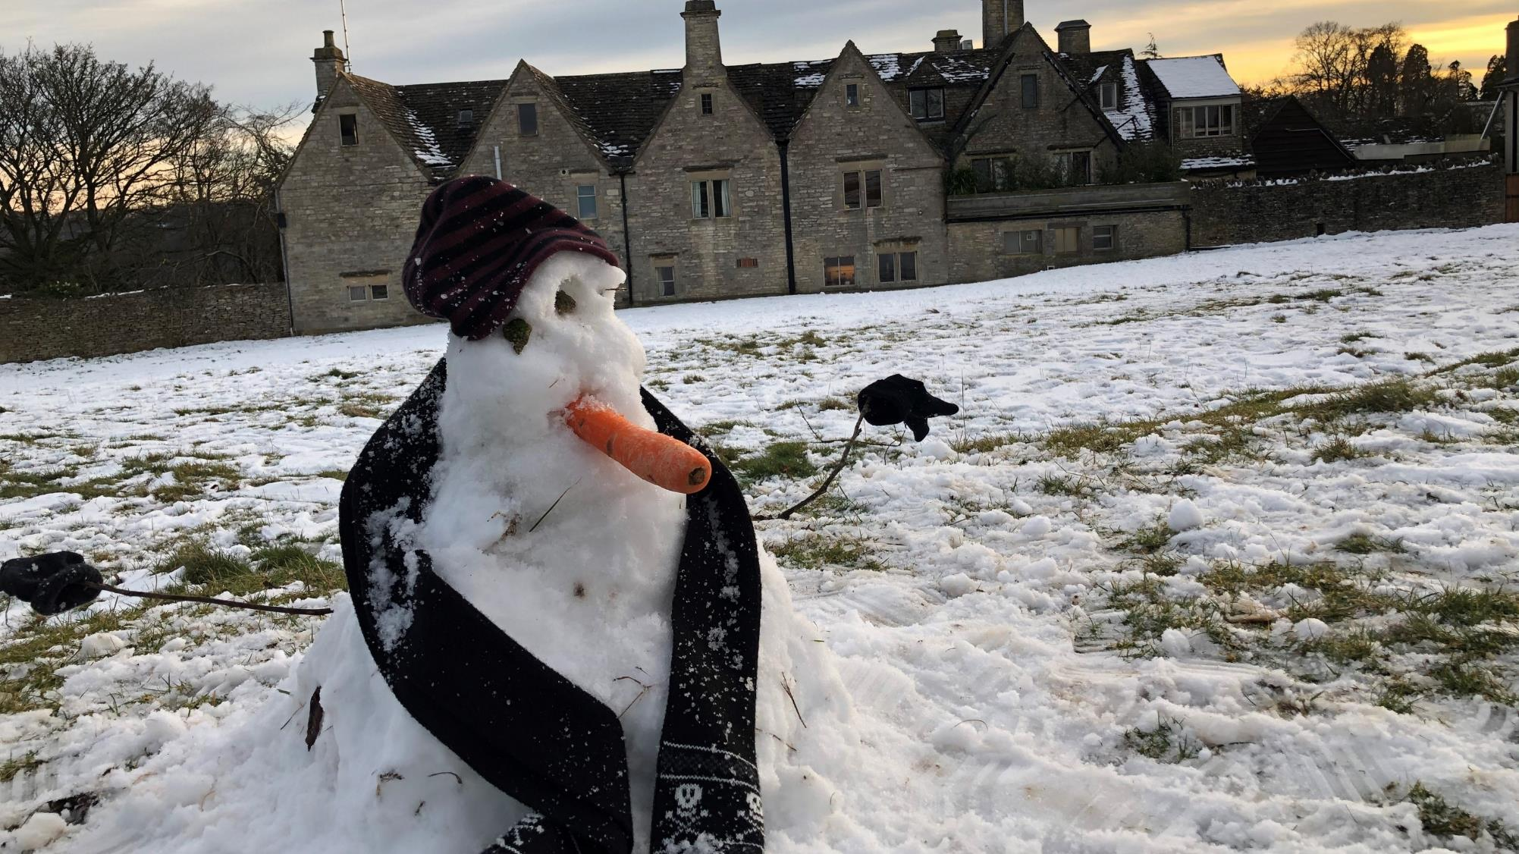

Values Vs Covid Jake Lukas Chief Executive Novalis Trust
Notes:
It felt like we had been trained and prepared for the pandemic to arrive at Novalis Trust.
Our journey into understanding trauma and its effect on organisations and individuals helped us understand what it was like to experience a global pandemic, numerous lockdowns and losses. Suddenly the world was experiencing trauma and unusually all at the same time, has there ever been a time in history when this was the case other then perhaps the 2nd world war, and yet its not been all bad.
Through established positive relationships people on the whole at Novalis have been creative supportive, energetic and resilient to a level that on the surface seems almost unimaginable,
that is until you begin to explore the journey we have been on in the last 10 years, through the creation of our model of approach and our determination to remain positive hopeful and focused on doing the right thing because it’s the right thing to do.
We have been judged as “outstanding” and “Inadequate” “life changing and “a cause for concern” and yet our environment, approach and even majority of our staff remain the same.
I am sure there are many stories similar to our own and our experiences will not be unique, what I have tried to do in this presentation is to organise and illustrate some of the thoughts feelings and events at Novalis as we along with you all, began to navigate the uncharted waters of Covid 19:
The remembering self-the experiencing self
Its not what happens it’s the story we tell of what happens
Are we coping with Covid?
Did we cope with Covid?
Hedonic psychology, Kahneman

Slide 2
Novalis Trust is a charity that operates Cotswold Chine School Paradise House and William Morris College. Founded in 1954 we provide for the education of children, young people and adults, including those with emotional and behavioural difficulties, and special learning needs.
Novalis Trust has an established practice model which is:
Trauma & Resilience Informed, Attachment Focused, Evidence Supported & Relationship based, implemented through a low arousal socially safe and sensitive environmental approach.

Slide 3
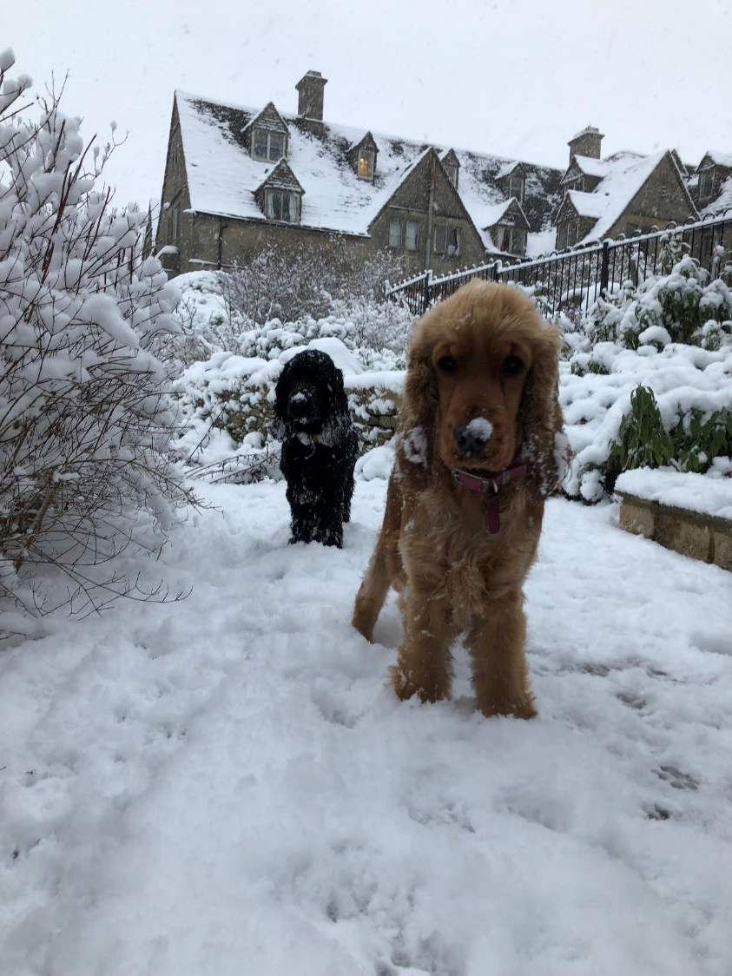
Cotswold Chine School
42 Residential placements
18 Day placements
Aged 7-19yrs
Rosa and Stan school support dogs in Cotswold Chine School Garden

Slide 4
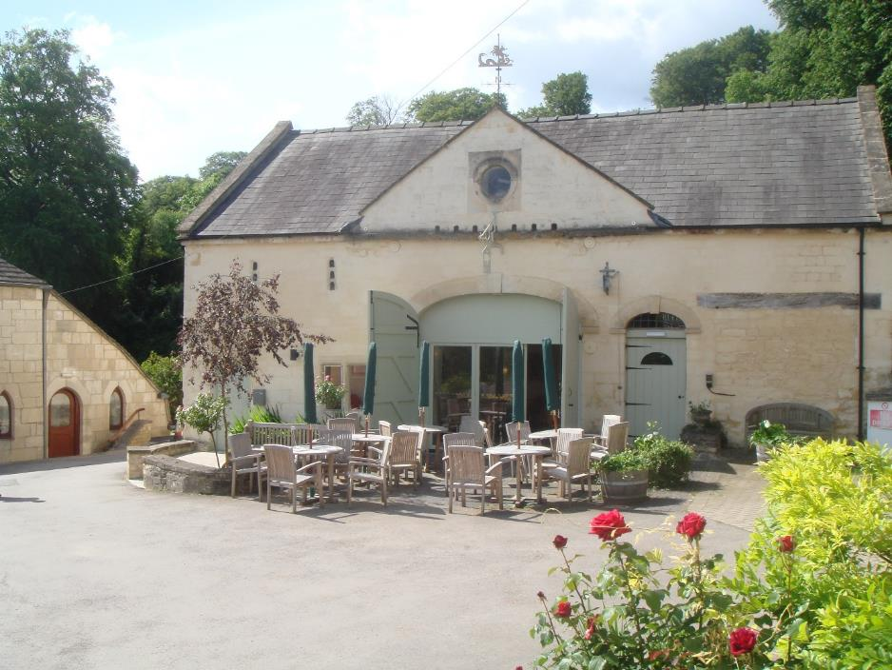
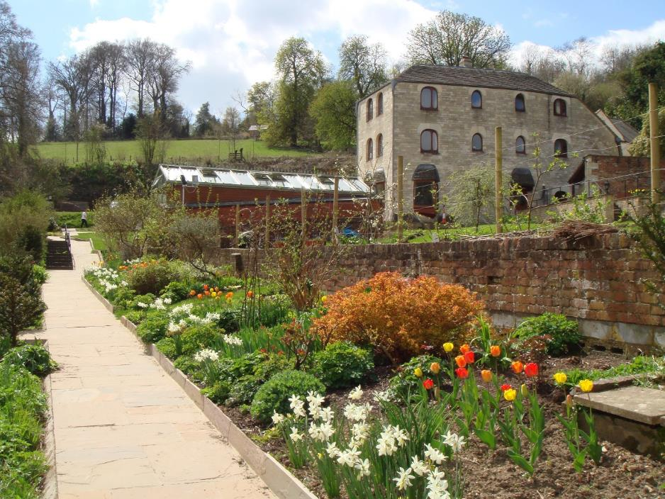
Paradise House
Registered Care Home for 34 adults 18-65years of age

Slide 5
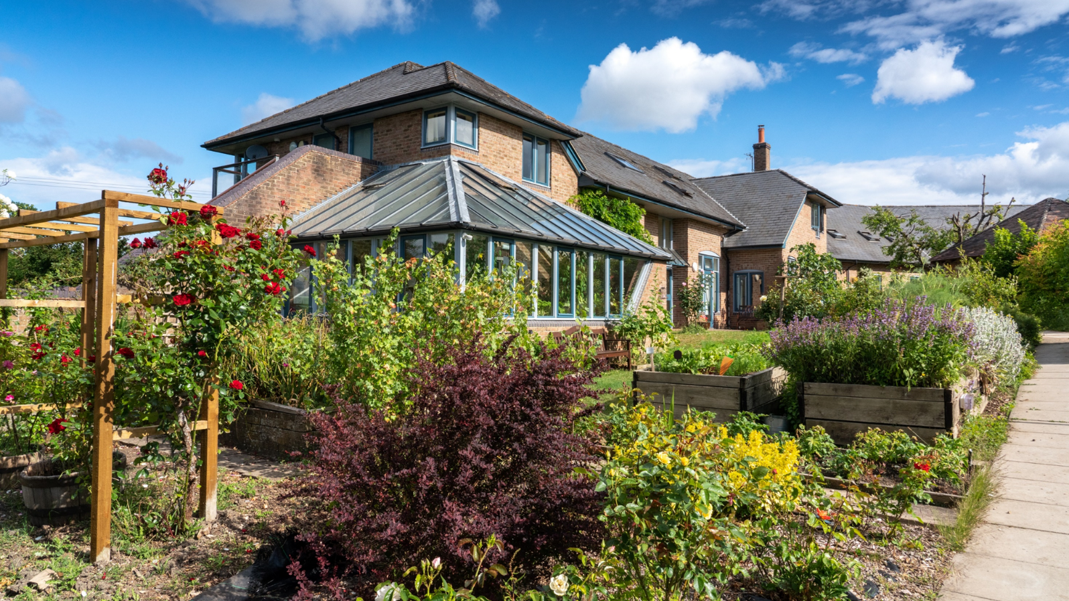
William Morris
School / College, post 16 and college for students
18-25 yrs.

Slide 6

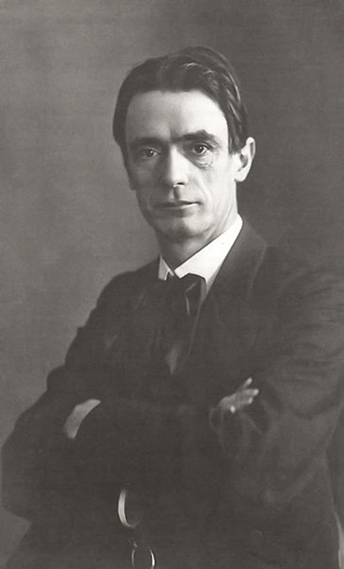
Rudolf Steiner was a philosopher, teacher, and doctor, he founded the Waldorf schools movement which now has over 2000 schools, 300 special education schools, 60 teachers' colleges in over 50 countries throughout the world.
“Practice Humility knowing that one can always learn especially from children”

Slide 7
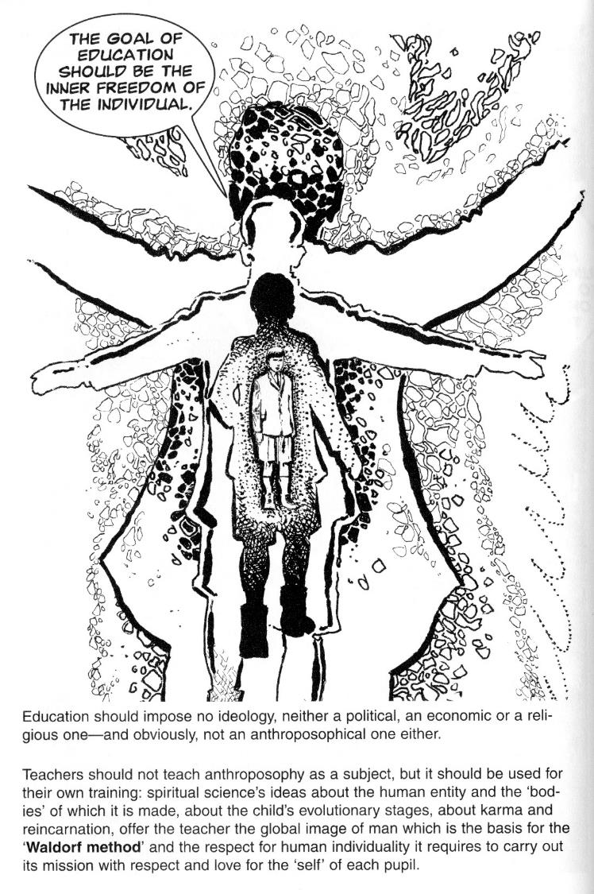
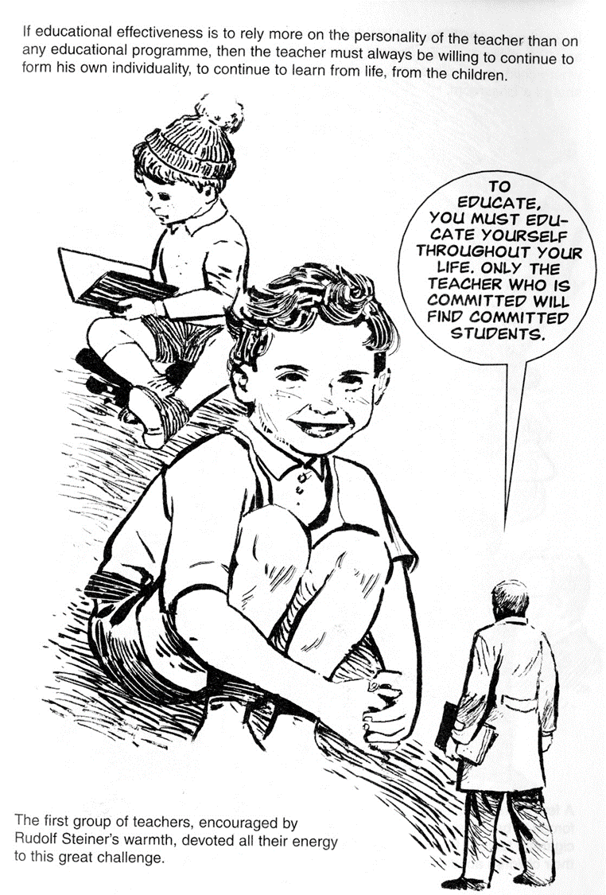
If educational effectives is to rely on the personality of the teacher and the strength of their relationship with children
The method of education practices a value base of respect for the human being, through love and freedom for the self.
The teacher must always be willing to develop and learn themselves, to learn from life, from the children in their care.

Slide 8
The Novalis Model of Approach
Trauma & Resilience Informed, Attachment Focused, Relationship Based, Evidenced Supported, Low Arousal Therapeutic School, College & Home Where Children Young People and Adults Live.

Slide 9
Trauma Informed- means that children and adults who have been traumatised can be supported by trauma informed staff to recover and feel safe.
S Bloom 2001
What do we mean by “Resilience?”
The capacity to rebound after disrupting events
The capacity to be generative & creative during times of relative stability
Anticipating potential difficulties and taking preventive actions
Threshold GlobalWorks (c) 2020
Emotional Resilience:
Emotional resilience can be developed through, a shared value base, positive relationships, reflective practice, support and empathy within likeminded people.
B Perry 2003

Slide 10
Attachment Focused-is established by facilitating a secure attachment with key adults.
Staff are trained to express empathy and acceptance of young peoples particular needs. At the same time staff are supported to encourage the young peoples ability to form positive relationships with key adults.
Within the safety of these relationships, young people are able to finally face and resolve difficulties.
People gradually develop a secure attachment and a positive sense of themselves, this encourages skills of emotional regulation, self care and life skills ready for moving on.

Slide 11
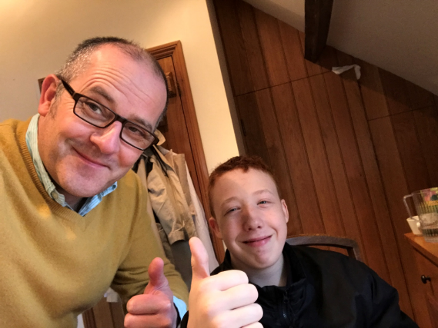
Relationship Based
Relationship Based-children young people and adults thrive through the establishment of positive relationships. Good relational health promotes a sense of physical, psychological, social and moral safety, a learning environment where needs are met and achievements are celebrated by everyone.

Slide 12
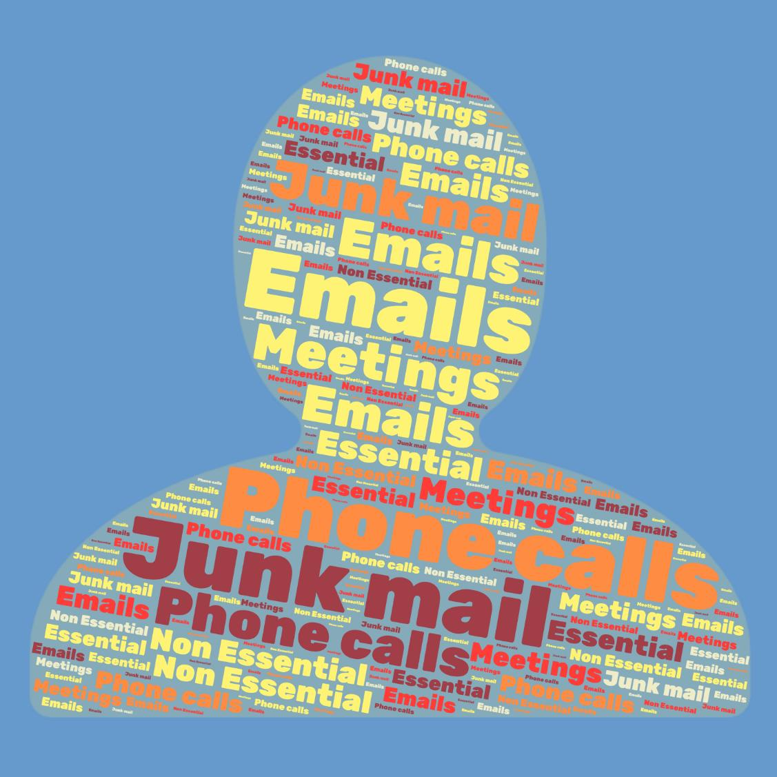
Before Covid
The amount of information we were expected to retain on a daily basis is unimaginable
Globally 144 billion emails per day
4.3 billion different senders per day
61% of emails non essential or irrelevant
William Utermohlen

Slide 13
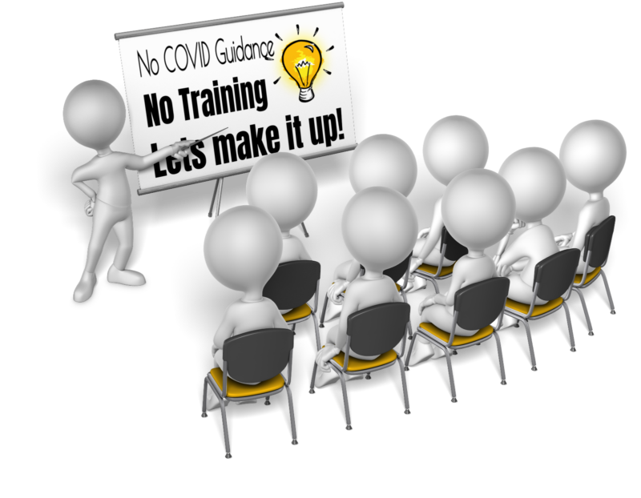
Staff need information:
We are so needy of this resource that if we cant get the real thing we just make it up.

Slide 14
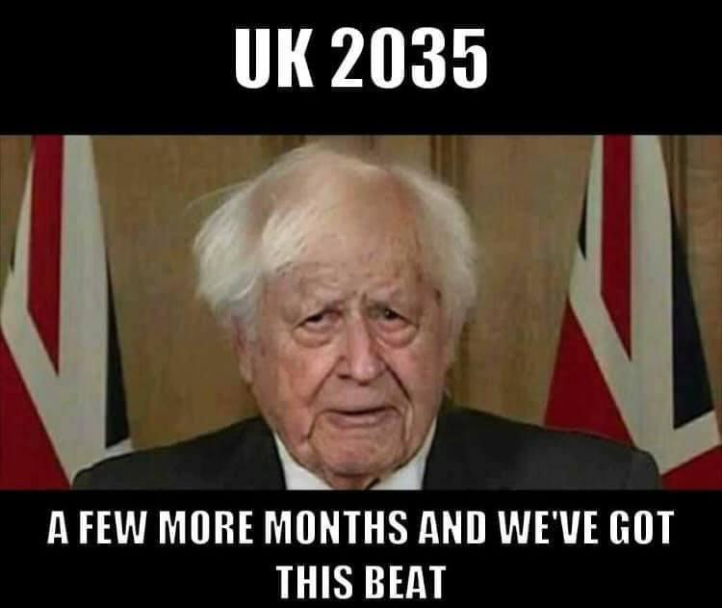
No guidance
Some guidance
Too much guidance
Conflicting guidance
No PPE
Masks don’t make a difference!
Masks are essential get your masks on!

Slide 15
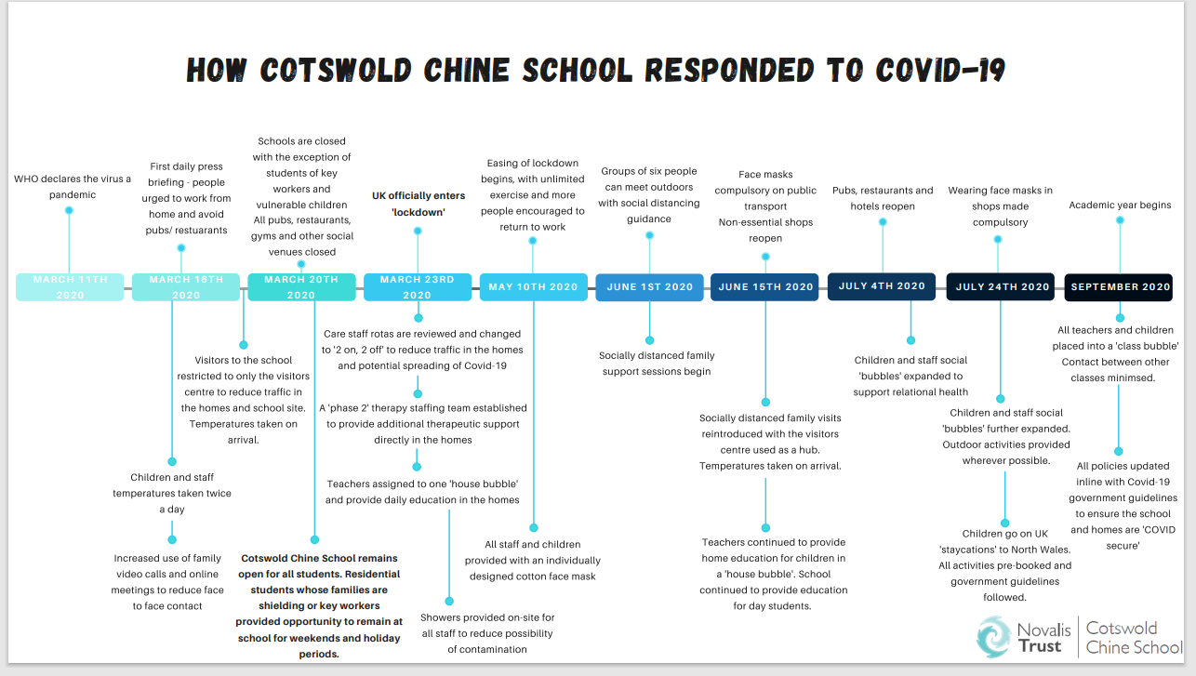

Slide 16
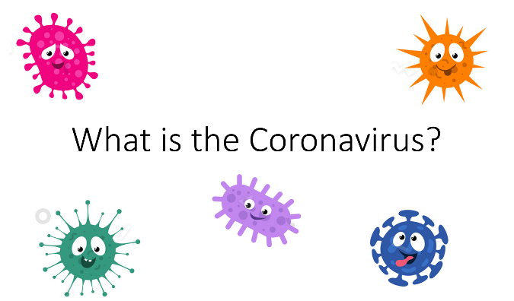
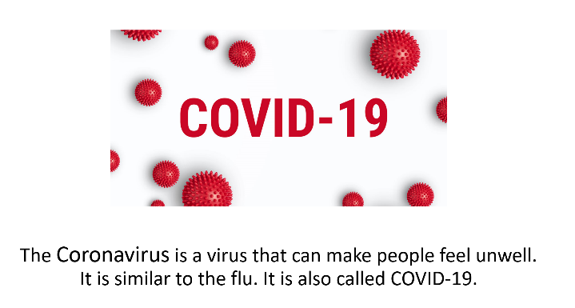
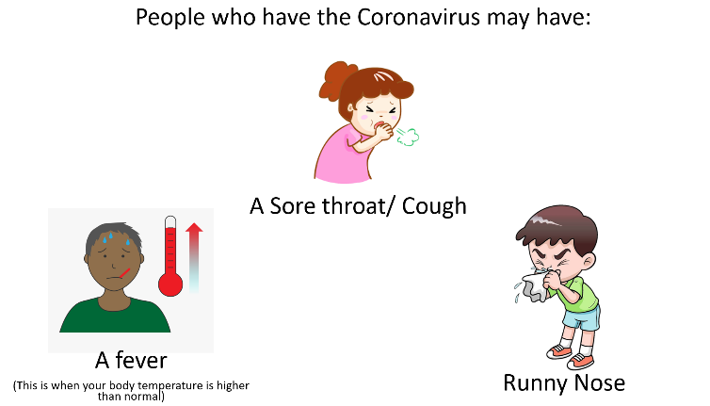
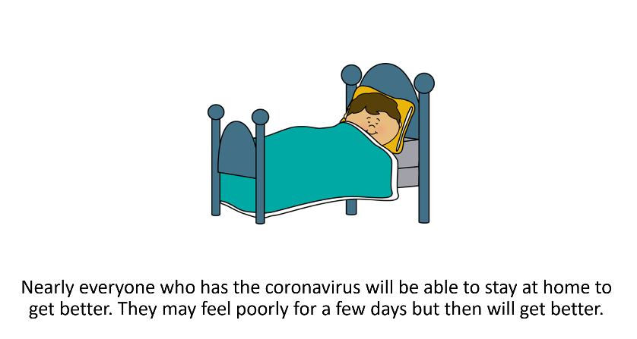
Covid
Social Stories

Slide 17
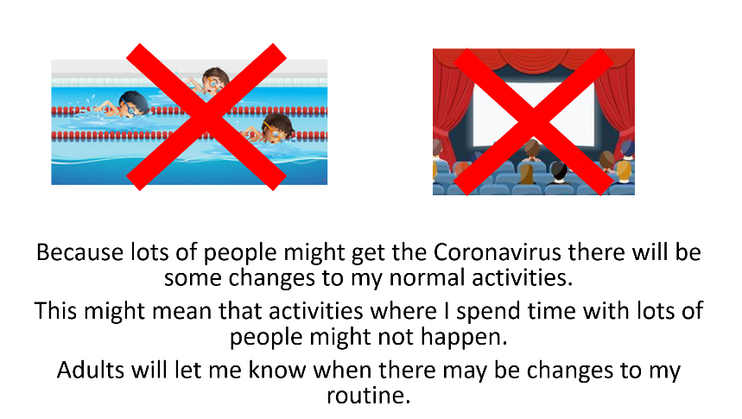
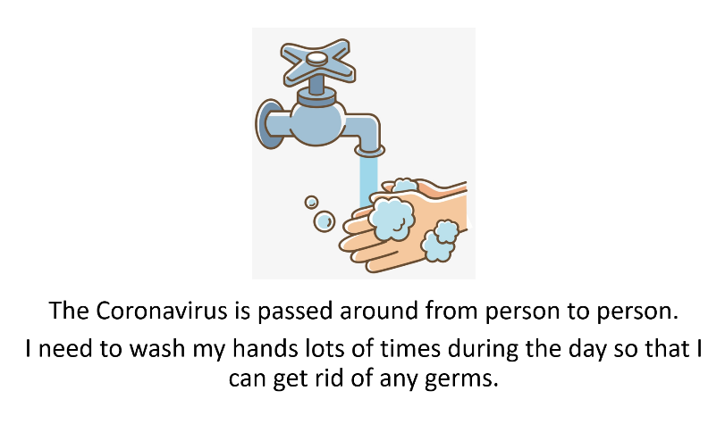
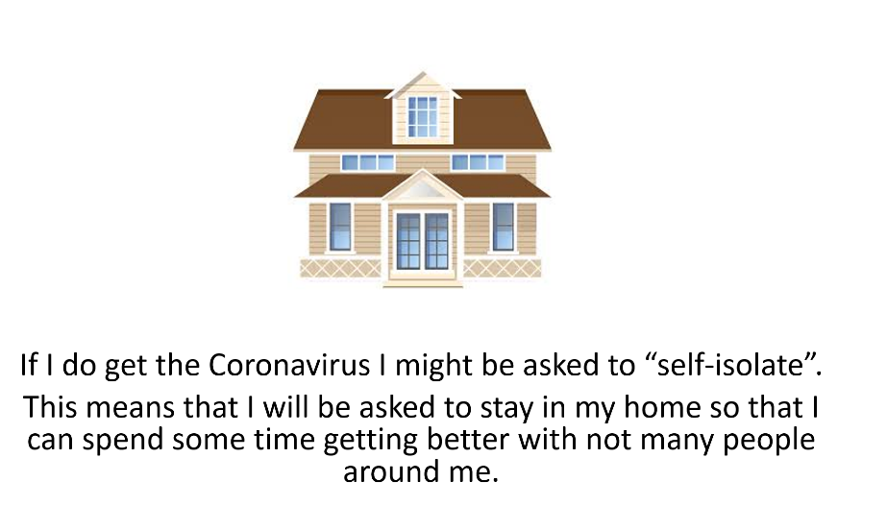
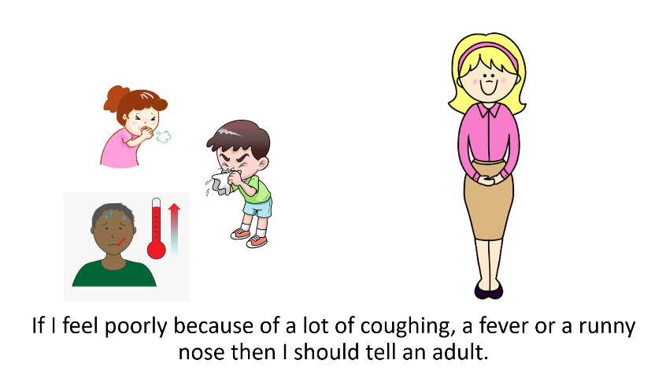

Slide 18
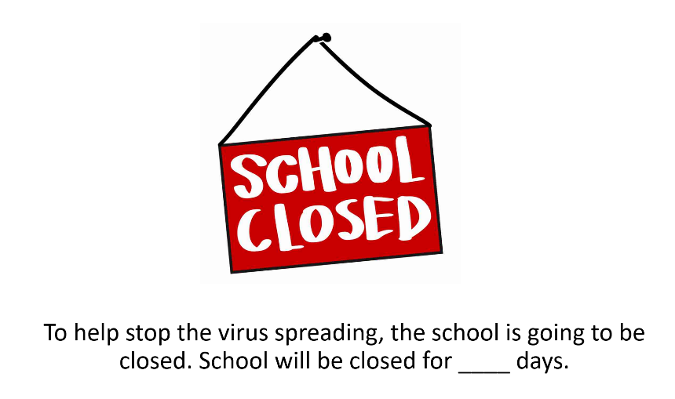
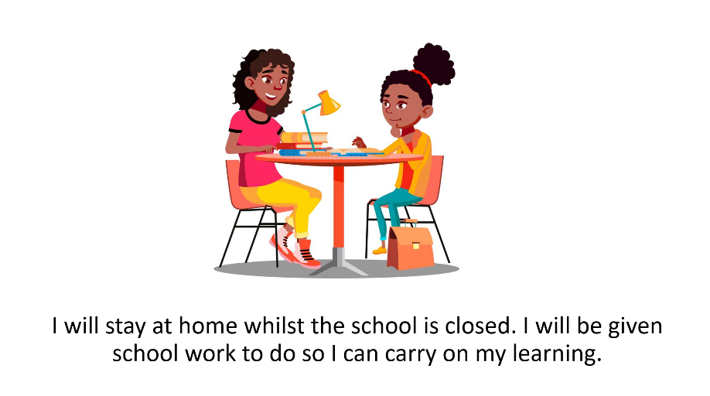
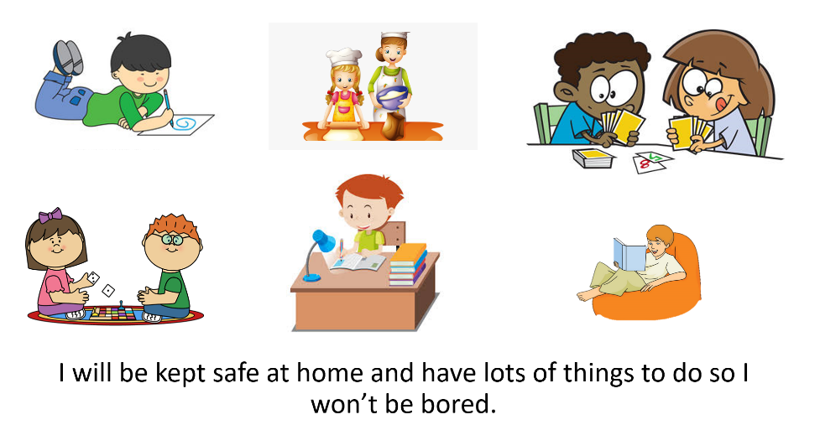
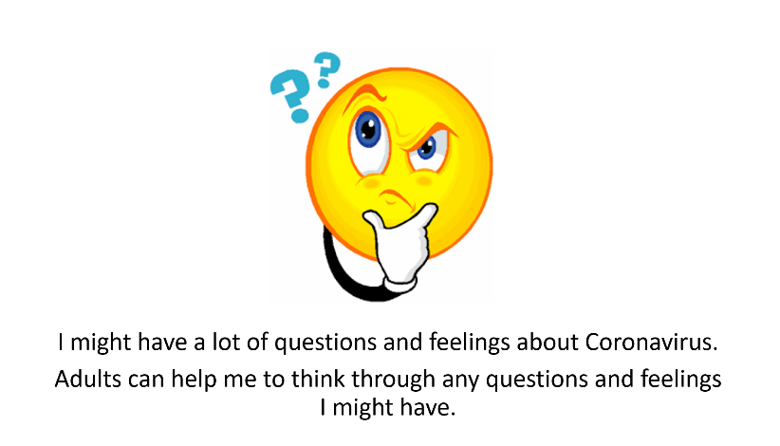

Slide 19
.
Conversations with our staff
Became difficult
1: The What Happened Conversation
2: The Feelings Conversation
3: The Identity Conversation

Slide 20

Most difficult conversations involve disagreement normally what happened? or what should happen?
Who said what?, who did what?, who’s right who’s wrong?, who’s to blame?, incidents at work often get stuck at the what happened ? stage, did we do the right thing?

Slide 21

How do we take care of those who care?
A recent YouGov survey showed 37 per cent of employees in the UK are suffering worse mental health now compared to pre-Covid levels.
28 percent believing their employer is currently not doing enough to safeguard their mental health.
Difficult conversations asks and answers questions about feelings. Are my feelings valid? Appropriate? Should I acknowledge or put them on hold? What to do about the other persons feelings? What if the other person is hurt or angry? if feelings are not addressed directly they tend to leak out anyway, in statements such as,
I’m really busy, I’m working really hard, I’m tired, I've been in everyday, what about my needs? What about my safety, my family?

Slide 22
The Identity Conversation
This is a conversation we have with ourselves about what this situation means to us, an internal debate takes place about whether or not we are a good person, competent or incompetent, worthy of respect kindness or blame.
How this may then impact on our self-image, concept of self, dignity, self-esteem and wellbeing.
How we feel and our answers to the questions posed will impact on our ability to feel balanced during the conversation, or whether we feel off centred or anxious.

Slide 23
Feedback is inevitable we found during Covid Choosing the wrong feedback often led to difficult conversations
What happened?
The feelings conversation
The Identity Conversation

Slide 24
Feedback: 3 different things with different purposes:
Appreciation-motivates and encourages
Coaching-helps increase knowledge skill, capability, growth or raises feelings in the relationship
Evaluation-tells you where you stand, aligns expectations, and informs decision making.
“A Person will only work to their highest level of perceived value”

Slide 25

Beware of Evaluation:
Evaluation can be a barrier to personal growth, positive evaluation can be as threatening in the long run as a negative one, since informing someone that they are good at something implies that you have the right to inform them they are bad at something.
The skill is to use the concept of empathy gratitude and appreciation.

Slide 26
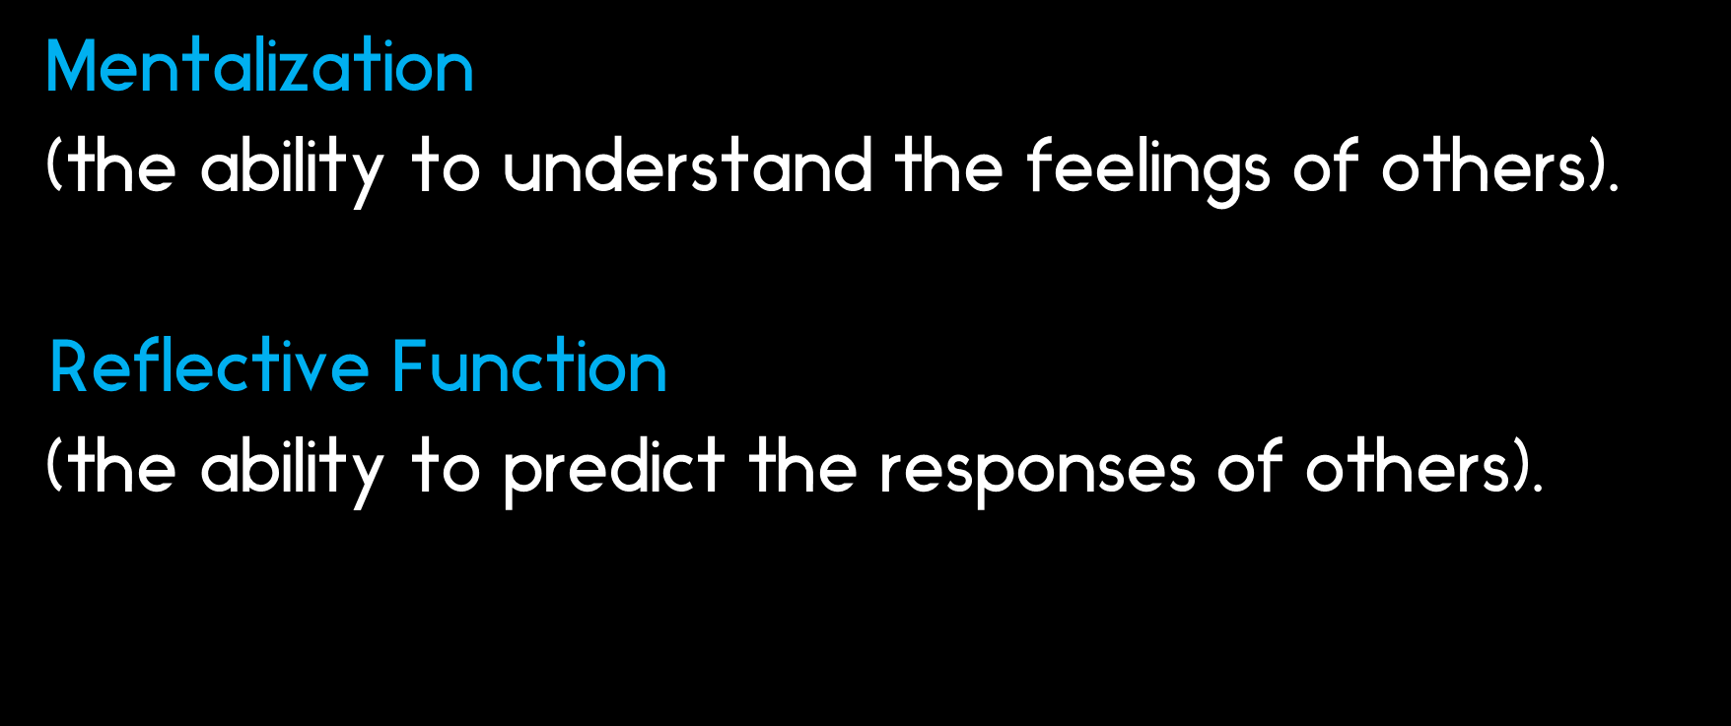
refers to the mind’s innate capacity to make sense of social experiences and implicitly know how to respond to them

Slide 27
We lost a higher percentage of staff from our 2019 appointments, compared to our 2020 appointments.
The quality of candidates improved as we moved later into 2020, as candidates had more time to see how their current employers responded to the pandemic
We became more familiar with video interviews and perhaps picked up on things we had missed previously, therefore making the process more effective.
As an organisation that promotes a relationship-based approach we do benefit from informal visits prior to formal interviews and that we are far better prepared for formal interviews, having observed candidates spending time with children/students/residents and staff at respective sites.

Slide 29
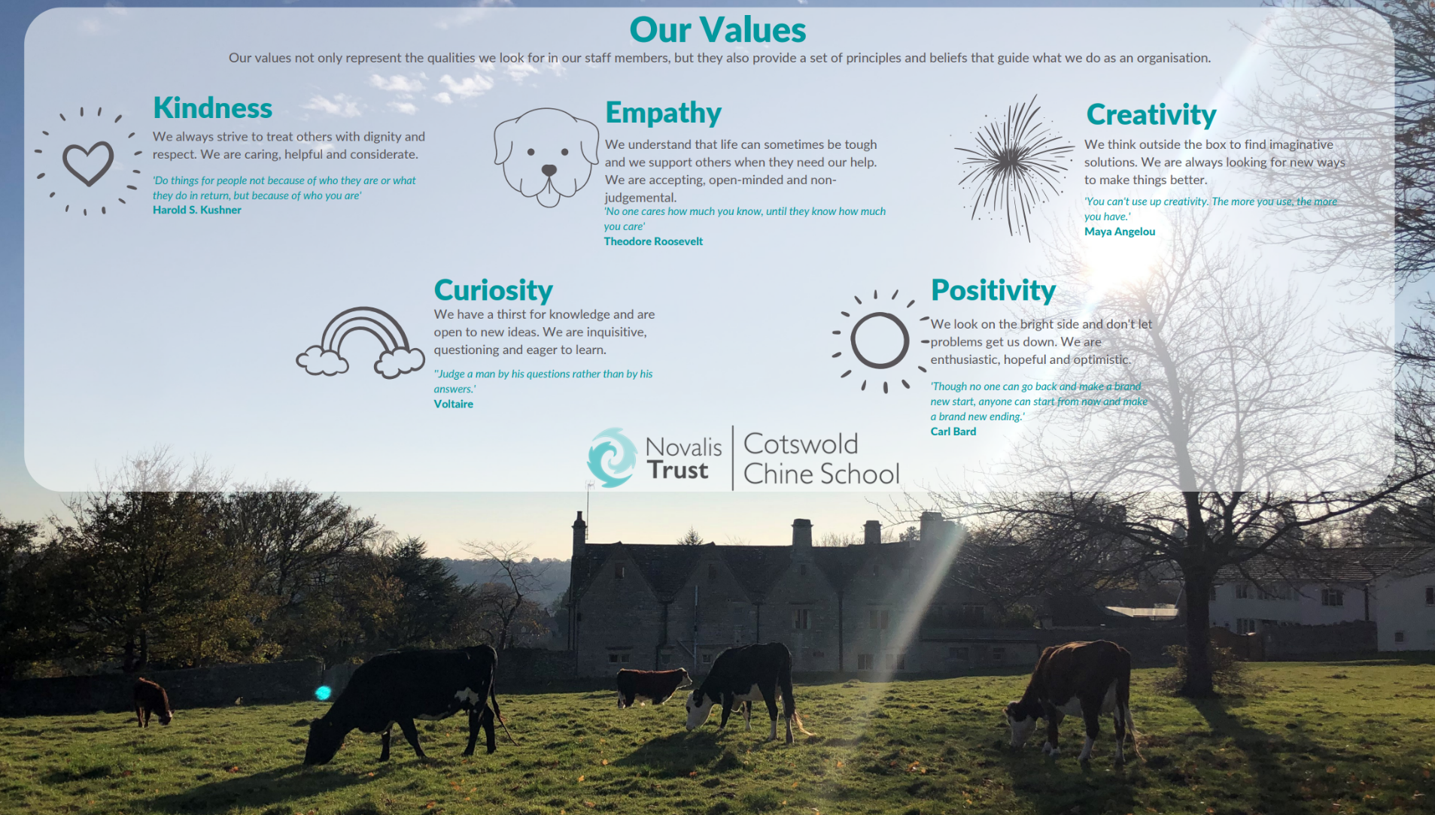
Notes:
Our Values
Our values not only represent the qualities we look for in our staff members, but they also provide a set of principles and beliefs that guide what we do as an organisation.
Kindness
We always strive to treat others with dignity and respect. We are caring, helpful and considerate
Empathy
We understand that life can sometimes be tough and we support others when they need our help. We are accepting, open-minded and non-judgmental.
Curiosity
We have a thirst for knowledge and are open to new ideas. We are inquisitive, questioning and eager to learn
Creativity
We think outside the box to find imaginative solutions. We are always looking for new ways to make things better.
Positivity
We look on the bright side and don’t let problems get us down. We are enthusiastic, hopeful and optimistic

Slide 30

Notes:
Stress creates tension in the nervous system, pushing it into 'fight or flight'; Kindness relaxes the nervous system, guiding it into 'rest and relax'. Stress increases blood pressure and kindness reduces it

Slide 31
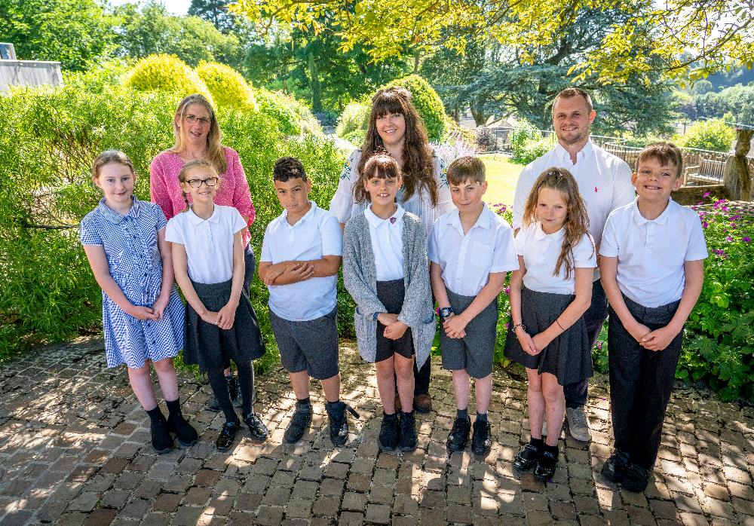

How is kindness valued at Novalis?
I think a lot of us have found the pandemic has led us to think more about what really matters to us.
In a national study two thirds of people stated this unprecedented time made people kinder. Perhaps because it was so difficult, people took more time to look after each other and noticed the small kindnesses that can make such a difference.

Slide 32
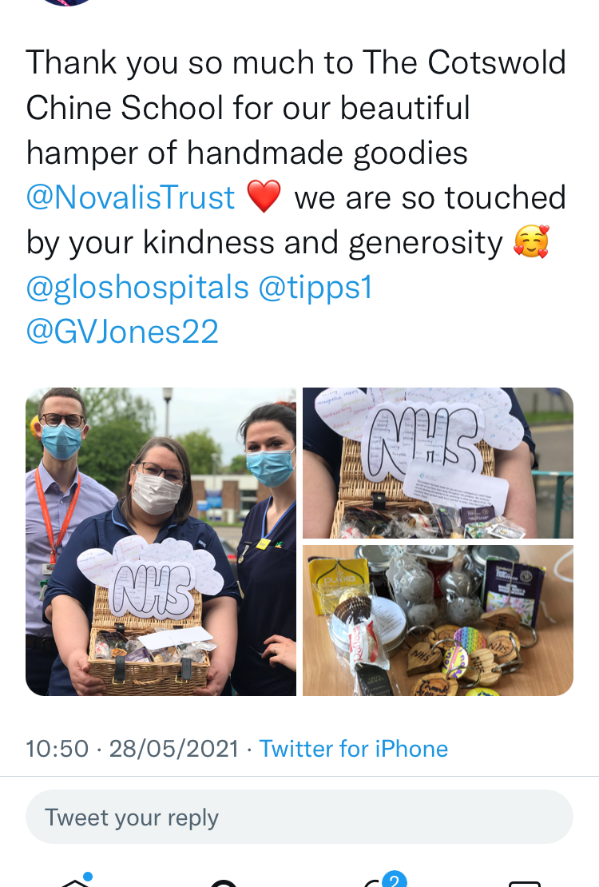
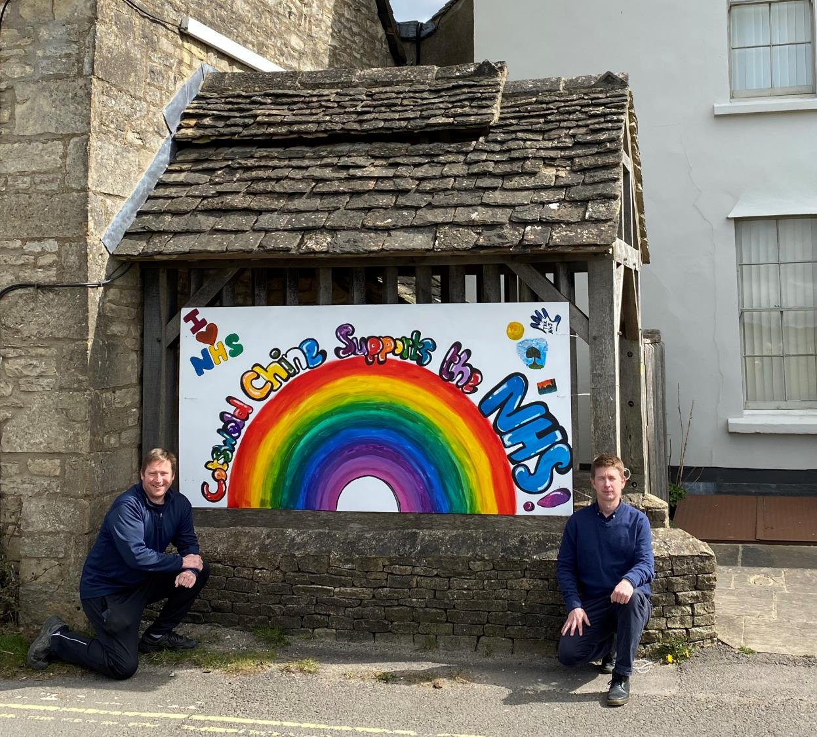

Slide 33
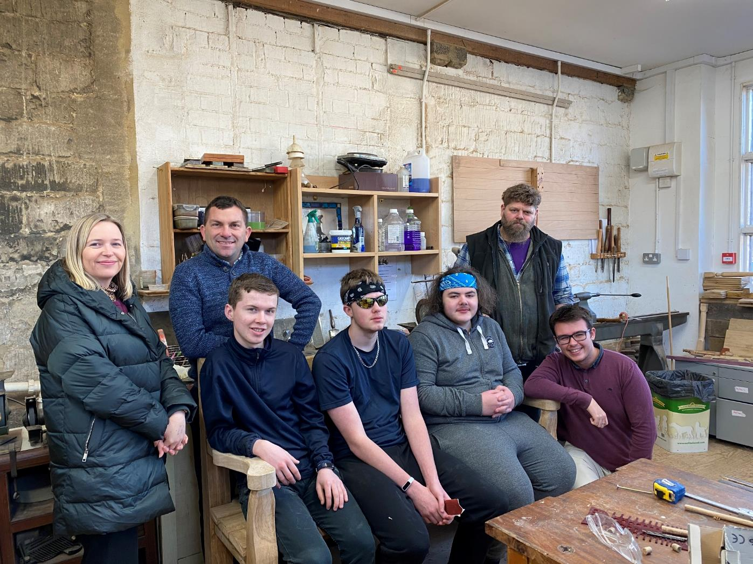
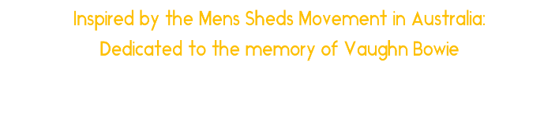
Boys at the Workbench

Slide 34
Boys at the workbench Project
Young men distressed or even depressed by major life transitions may express aspects of this state in irritation, aggression and sometimes violence against themselves or others.
Our aim is to provide activities and experiences where they can regain a sense of meaning, direction and purpose.
Group projects that benefit others creates a sense of moral purpose and meaning, difficulties can be discussed in a less intrusion way.
An extension of our Time In not Time out approach to working with young people
A sense of being, belonging and becoming.
Raphael et al 1999, & Cochran, S. V., & Rabinowitz, F. E. (2000).

Slide 35
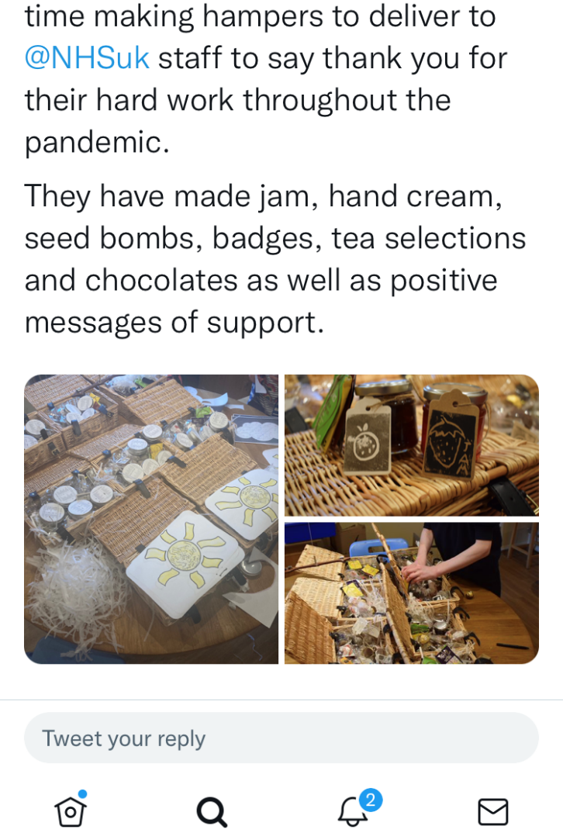
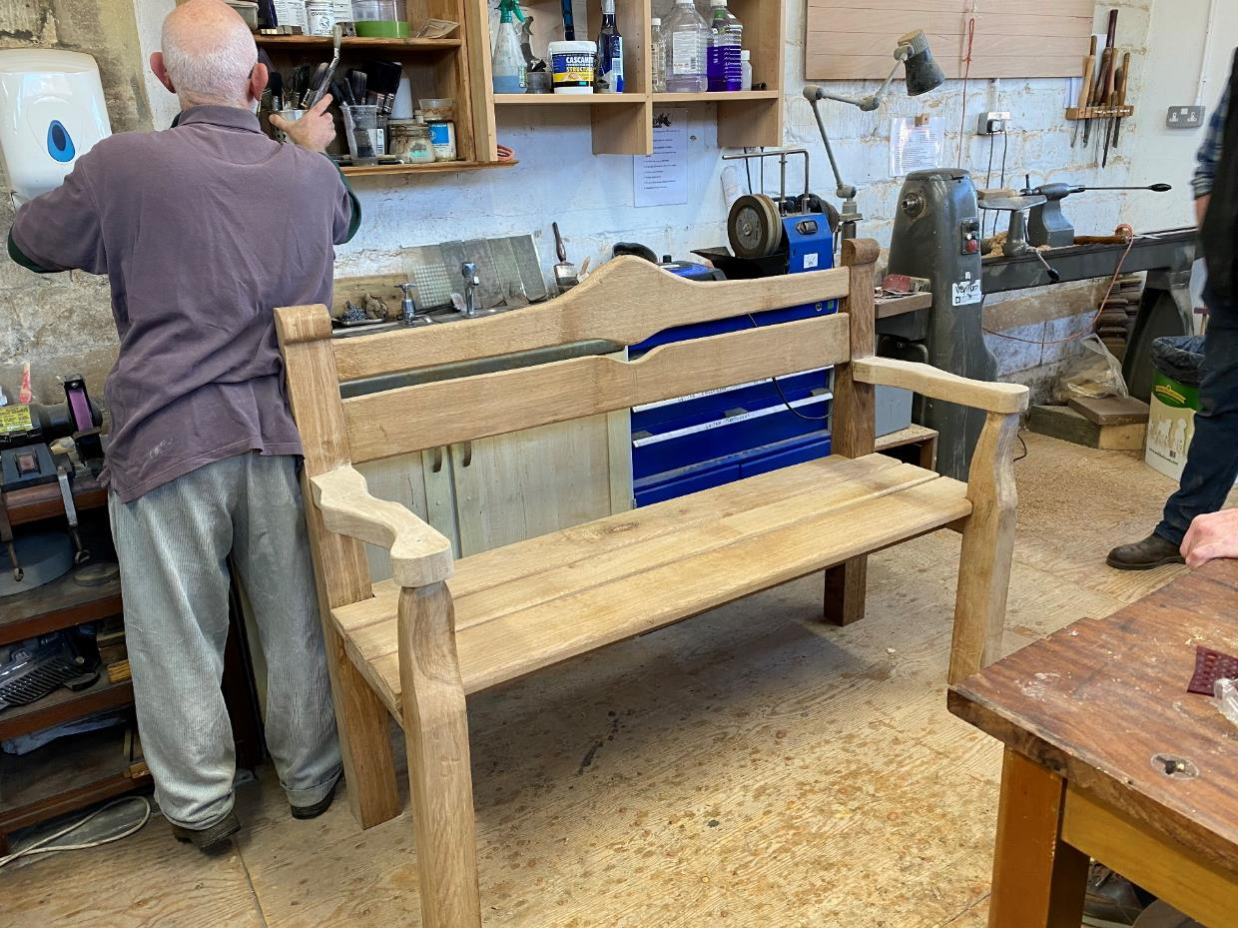

Slide 36
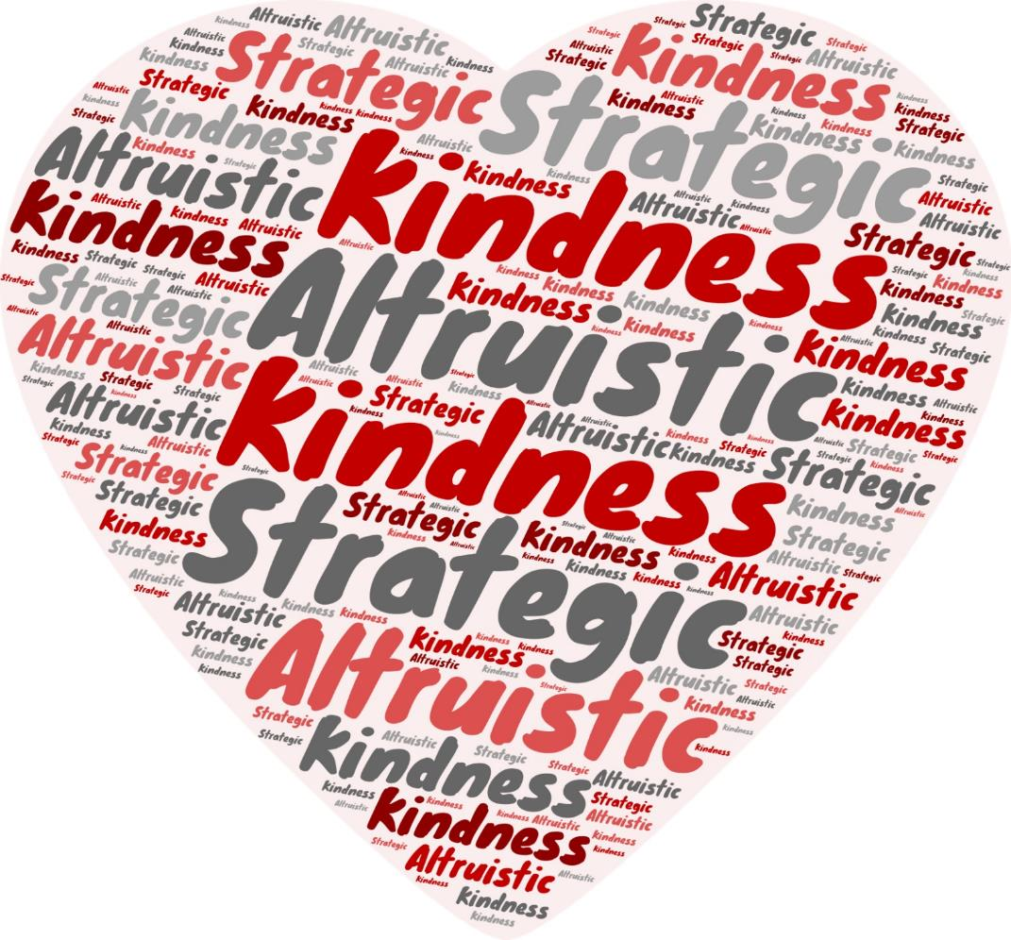
Kindness
Altruistic and Strategic

Slide 37
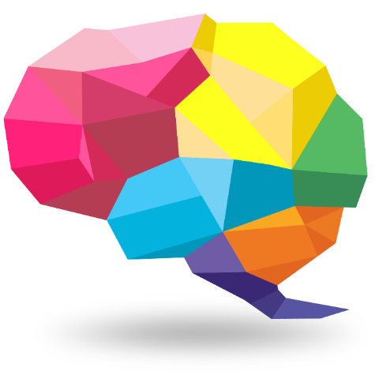
Being Nice To Someone Literally Makes Your Brain Light Up
Altruistic kindness refers to a selfless act of kindness, like paying for someone else’s meal or helping someone carry their shopping.
However, if you know you will meet again, your kindness may be perceived as strategic, even in cases when it is not. Strategic kindness is termed “Instrumental Reciprocity” or “Strategic Reciprocity”
Sobel, 2005, Cabral et al., 2014 ).
Strategic kindness,
Lights up a whole spectrum of the brain. It activates parts of our cortex, which is involved in mood, making us feel positive, if we are being positive and generous we also activate the ventromedial prefrontal cortex, which affects our decision-making and is a crucial part of making empathetic decisions that bond us to others.

Slide 38

Empathy is a skill like any other human skill. If you get a chance to practice, you can get better at it.
Simon Baron Cohen

Slide 39
Cognitive:
“Simply knowing how the other person feels and what they might be thinking. Sometimes called perspective-taking.”
If you imagine yourself in someone else's shoes, you know they are likely to be feeling sad, as well as anxious because maybe they are concerned about money. However, having only cognitive empathy keeps you at a distance. To truly connect with your you need to share feelings. This is where emotional empathy comes in.
Emotional:
“When you feel physically alongside the other person, as though their emotions were contagious.”
This type of empathy can also extend to physical sensations, which is why we cringe when someone else stubs their toe. In this case, you would look inwards to identify a situation where you were similarly anxious about the future.
Compassionate:
“With this kind of empathy we not only understand a person’s predicament and feel with them, but are spontaneously moved to help, if needed.”
It is the balance between Cognitive and Emotional Empathy that enables us to act without being overcome with feeling or jumping straight into a problem solving process.

Slide 40


Slide 41
Being Curious about Covid?
Open curiosity about a young person's thoughts and feelings and intentions is likely to facilitate their interest in their own inner life, this in turn helps attuned adults engage and move to a place of co-creation:
1: People are talking about this virus called Covid, I wonder if you have heard anything yourself?
2 We are having to make some changes, such as teaching and therapy moving to the homes, How do you feel about that?
3: You said your worried about your family getting Covid would you be able to talk a little more about that?
4 What does the idea of lockdown mean to you?
5: What do you want to happen?
6: If we all do this what do you expect will happen next?
7: You seem to be really looking forward to that, do you need anything from us?
8: I think I do understand what this means to you, but I just wanted to ask am I missing anything?
9: Covid has been tough for everyone I wonder if you could tell me something you have done that was fun?

Slide 42

DDP
Dyadic Developmental Psychotherapy
(Psychotherapy is a way of helping people find a way to tolerate what they are feeling and what they are experiencing within their bodies, Van Der Kalk 2018)
PACE
Playfulness, Acceptance, Curiosity Empathy
“Connection before Correction”

Slide 43
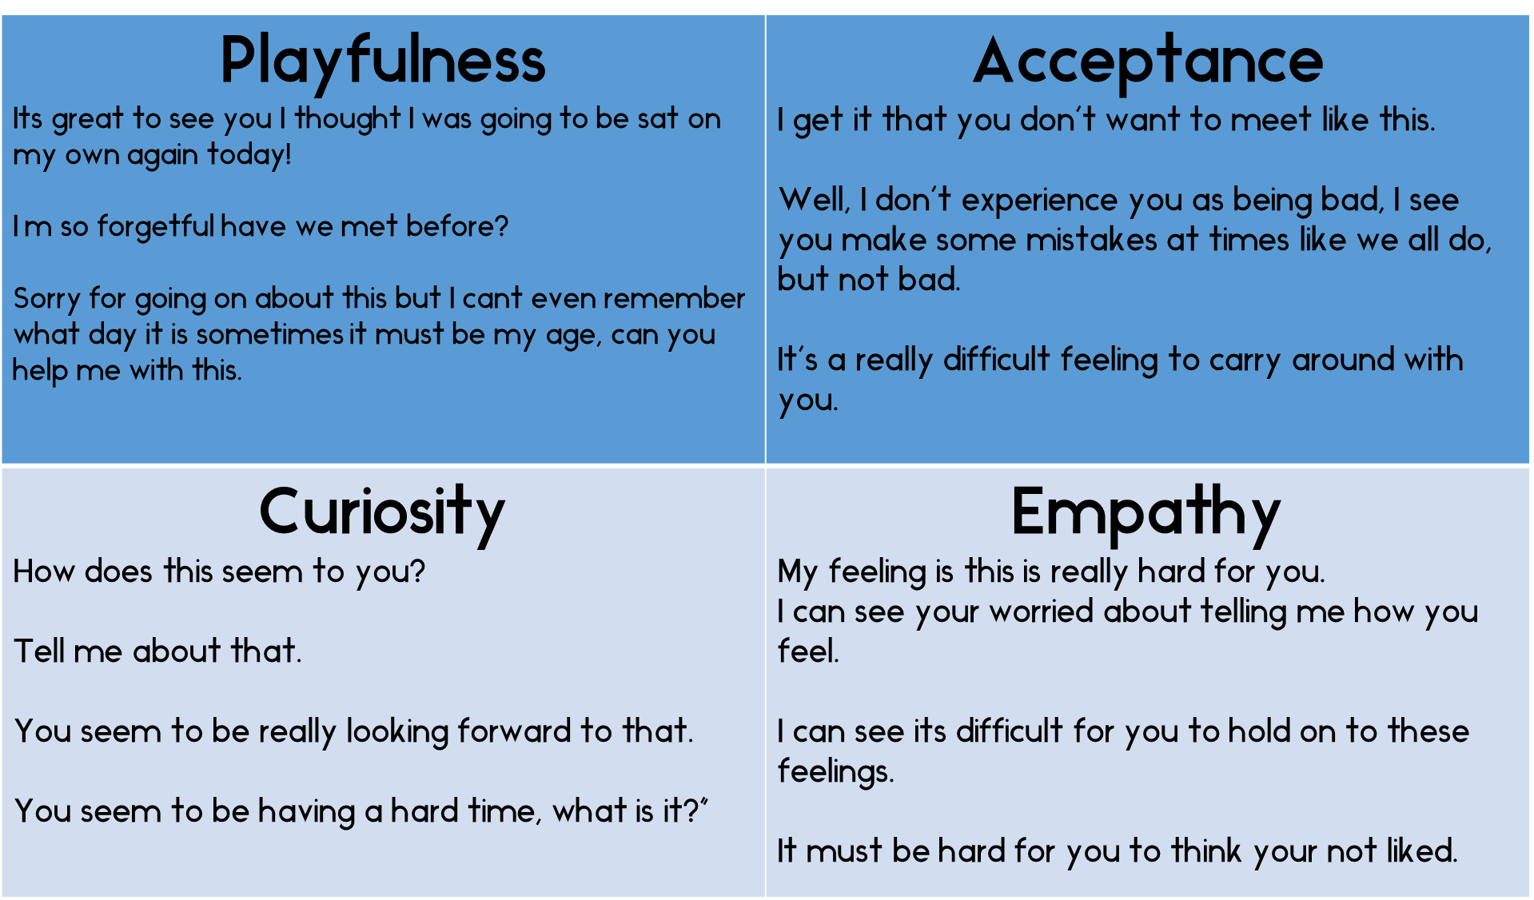

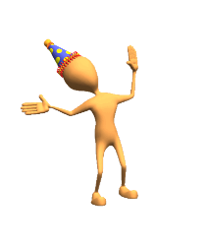

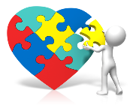

Slide 44


Slide 45
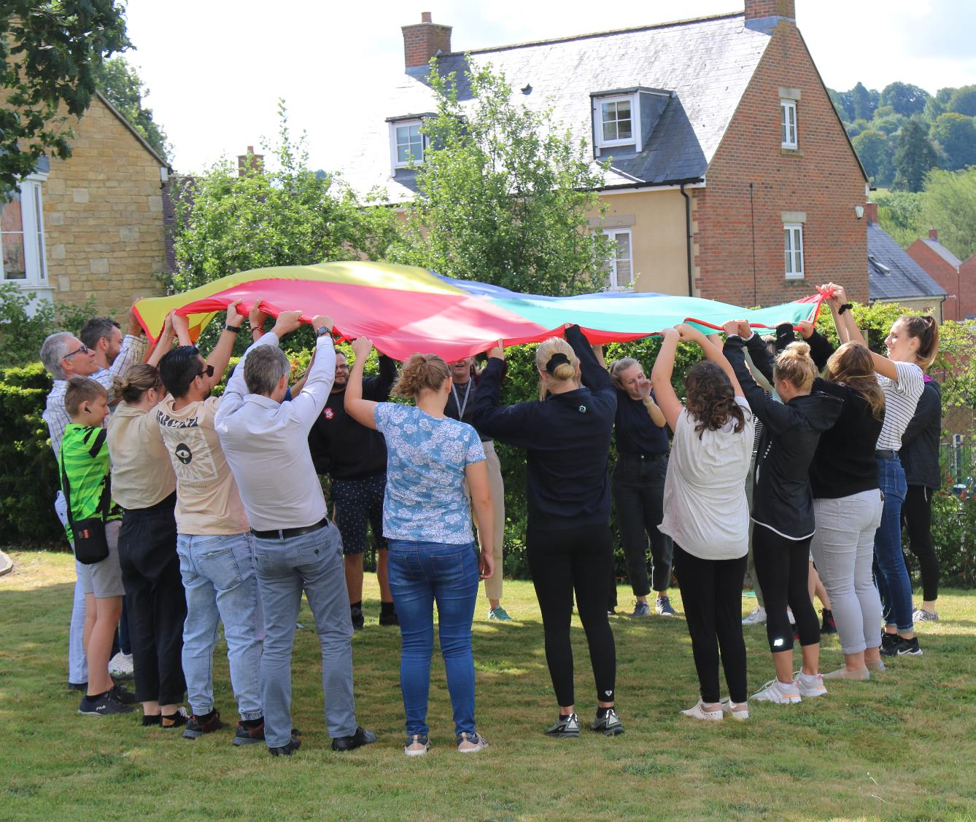
Healthy human beings enjoy laughing, playing, and having a good time. They experience humour as a form of personal and shared intimacy between people.
Dr Sandra Bloom Creating Sanctuary 1997

Slide 46
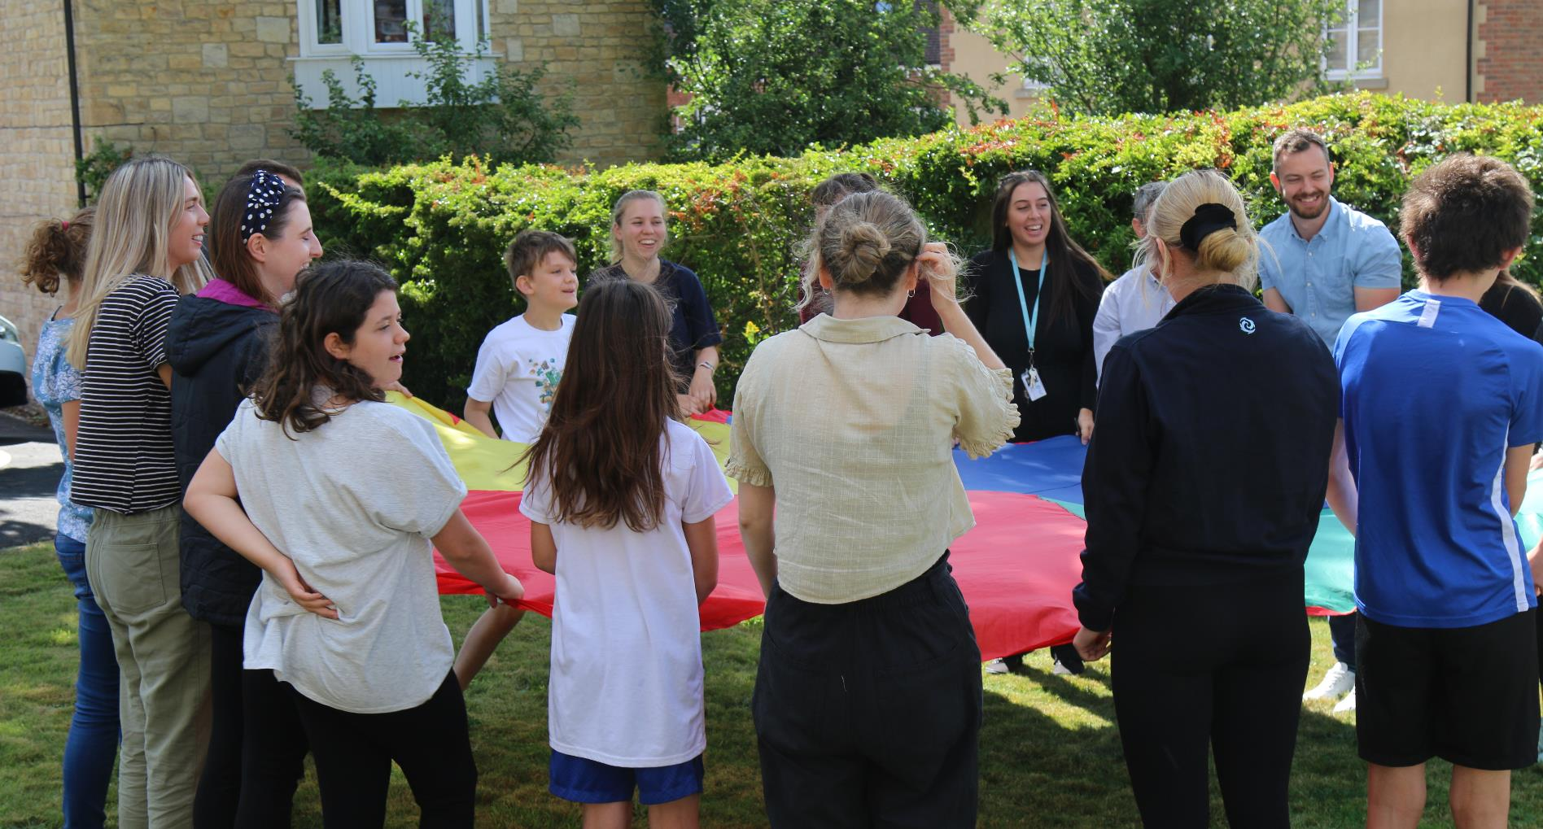
Intersubjectivity:
Refers to the process whereby the subjective experience of each member influences the subjective experiences of their care giver or attuned adult.
The way attuned adults experience the young person will influence and assist in the way they experience themselves,
Notes:
Happiness:
Remember that the happiest people are not those getting more, but those giving more
Laughter is contagious pass it on freely.

Slide 47
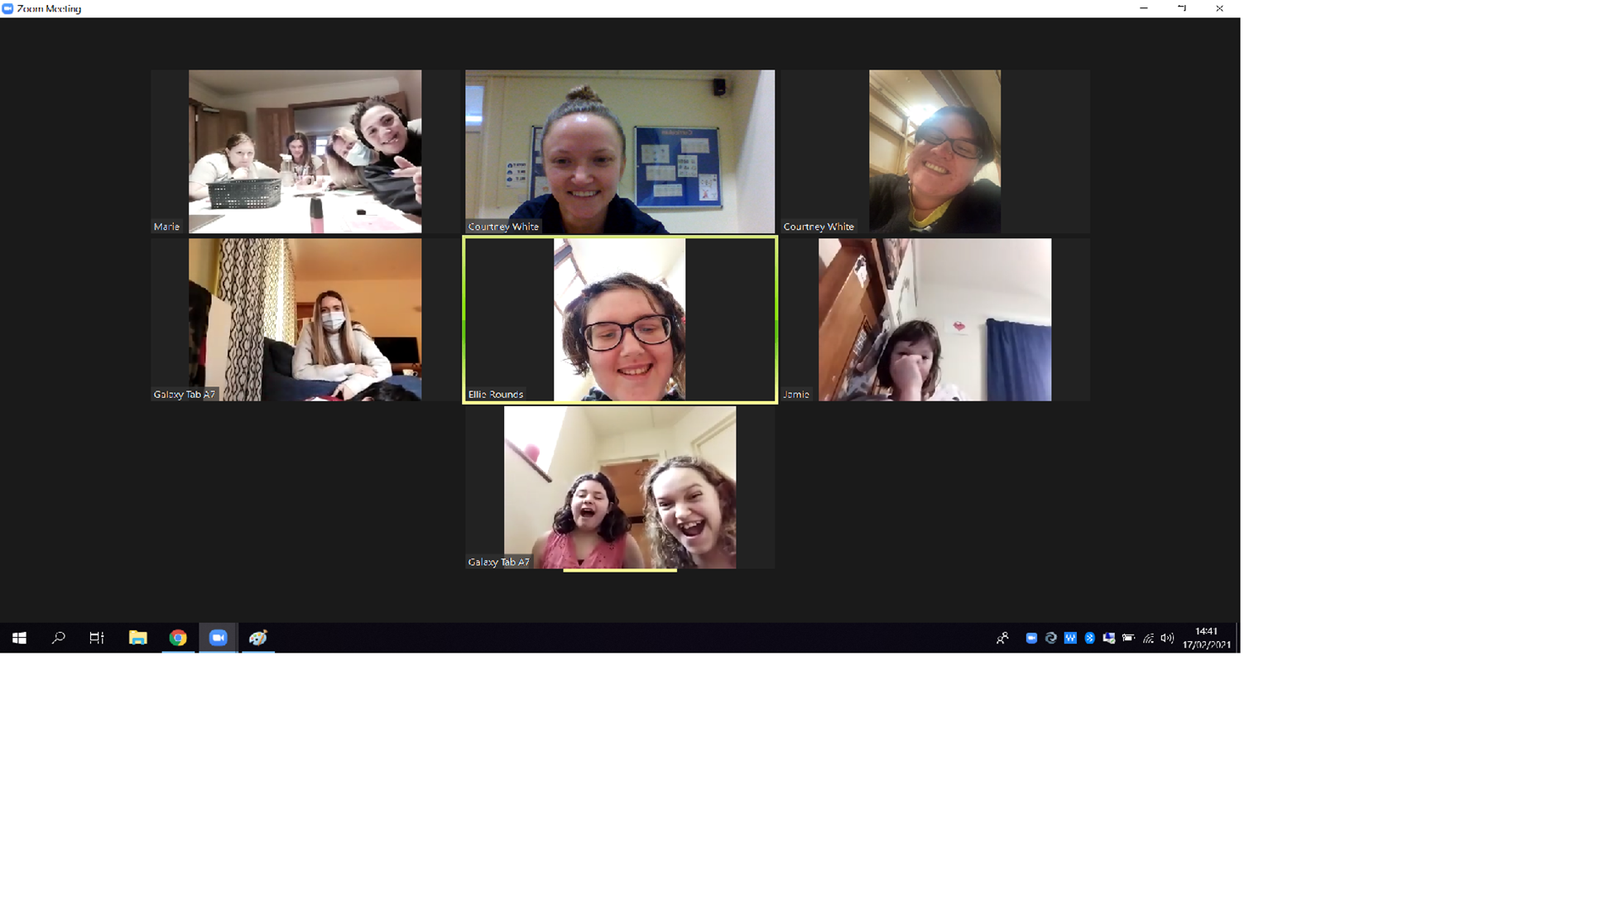

Slide 48
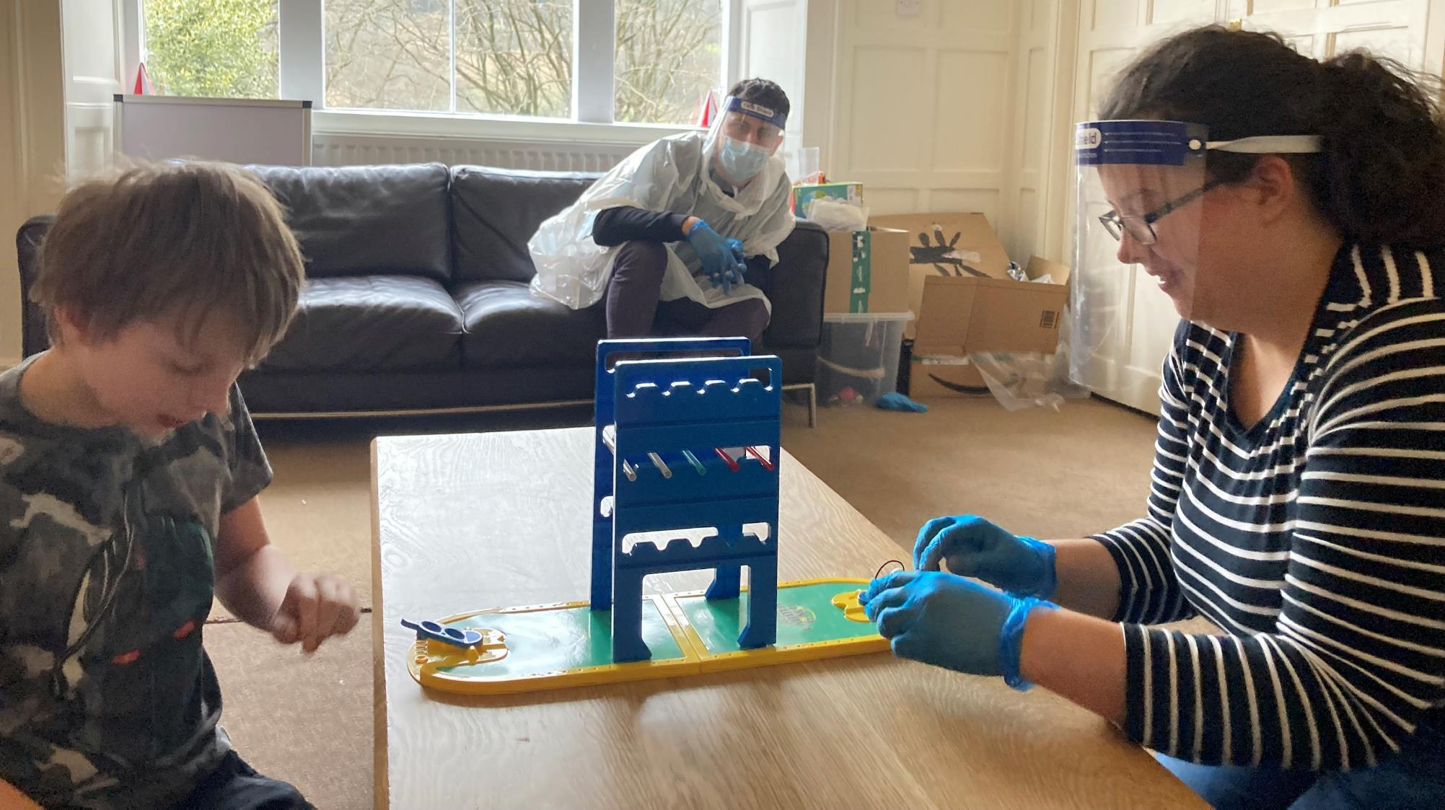
Humour with children allows for relationship repair often in times where negative affect states become too difficult for children to bear, laughter enables both adults and children to enter into a playful interaction……
Dan Hughes Attachment Focused Family Therapy 2007

Slide 49
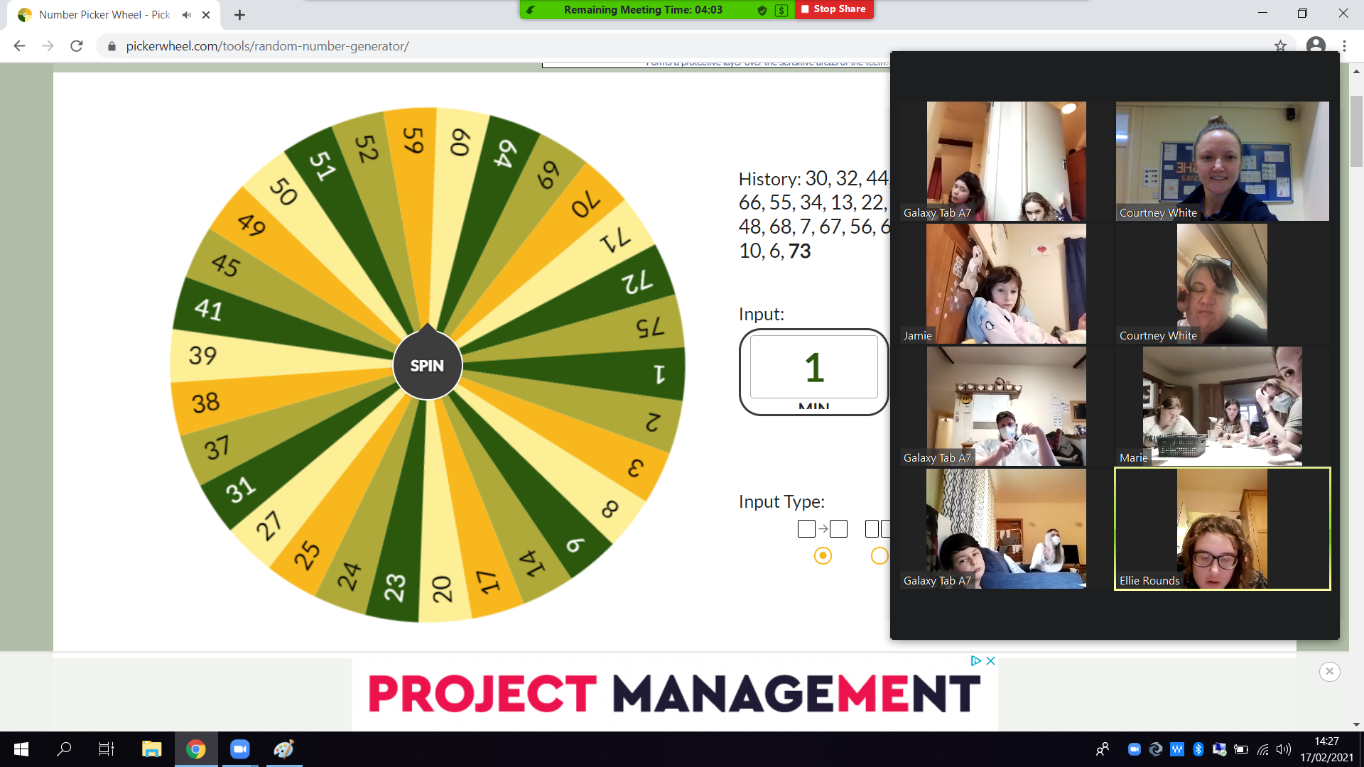

Slide 50


Slide 51
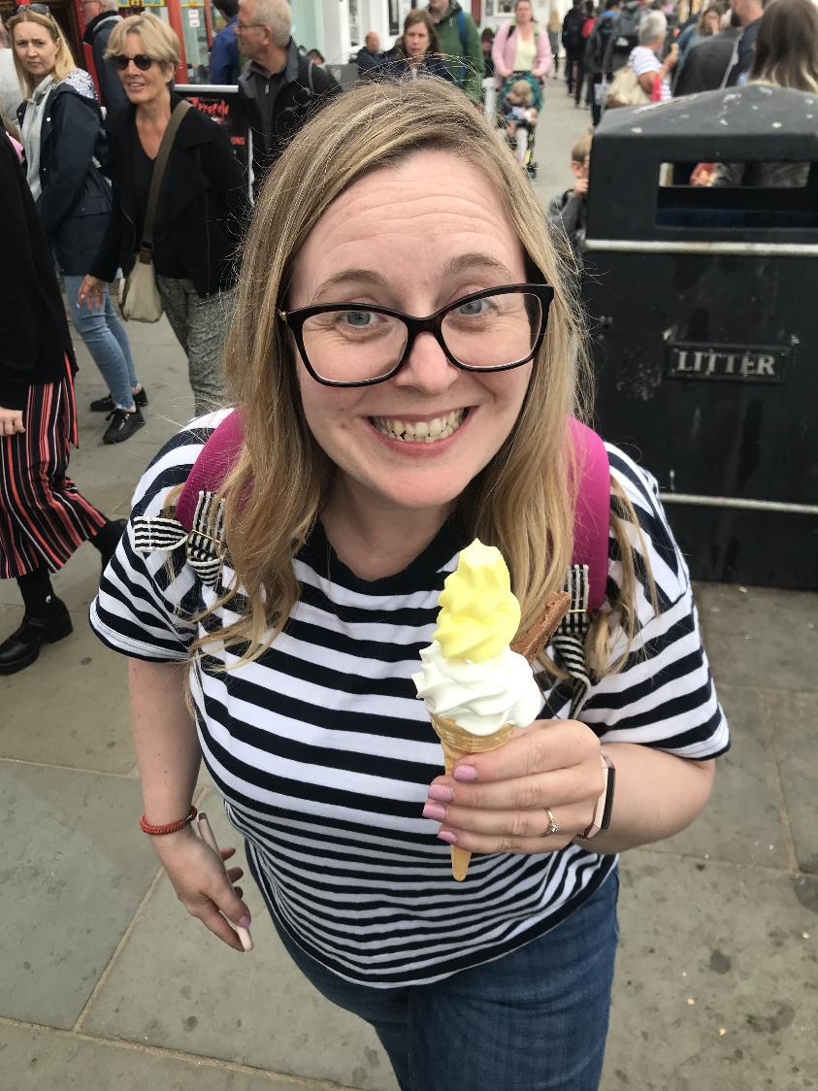
Hope is the ability to see a future that’s better then the present , and it’s the power to try to make it happen.
Changing Outcomes with Optimism
Dr Alan Hamilton 2013
Good leaders are a SPONGE to soak up the rubbish, and prevent it affecting everyone, soak up don’t amplify
Dr Bruce Perry 2022
A funny thing happens when leaders consistently act in alignment with their principles and values: They typically produce consistently high performance almost any way you can measure it.
Lennick & KieL, 2005

Slide 52
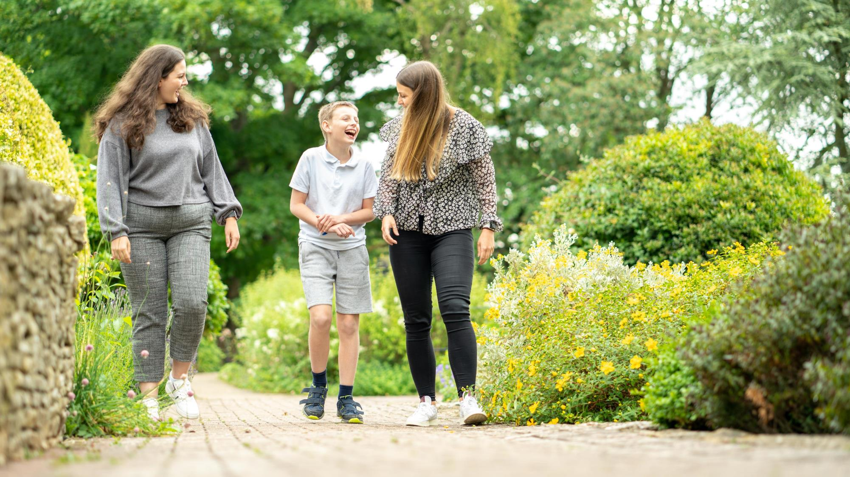
Regulated leaders can regulate colleagues, regulated colleagues can regulate children and young people.

Slide 53
Staying Regulated During Covid
Co-regulation: is a biological imperative: a need that must be met to sustain life. It is through reciprocal regulation of our autonomic nervous states that we feel safe to move into connection and create trusting relationships.
Self Regulation: can be defined in various ways. In the most basic sense, it involves controlling ones behaviour, emotions, and thoughts in the pursuit of long-term goals. More specifically, emotional self-regulation refers to the ability to manage disruptive emotions and impulses.

Slide 54
The children and young people we work with are often hyper aroused and hyper vigilant, they have experienced childhood trauma and adversity:
young people are often in an
arousal state,
An individuals true cognitive and relational capabilities cannot be accurately
determined until they are regulated.

Slide 55
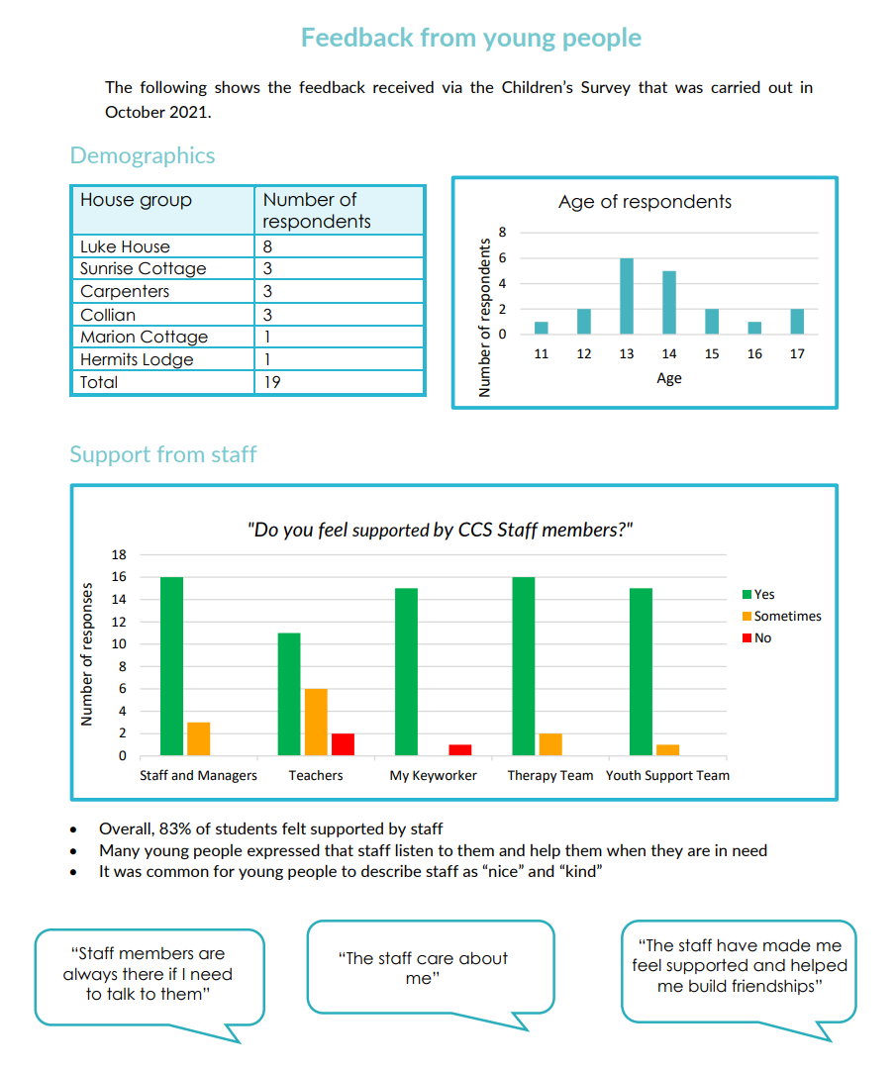

Slide 56
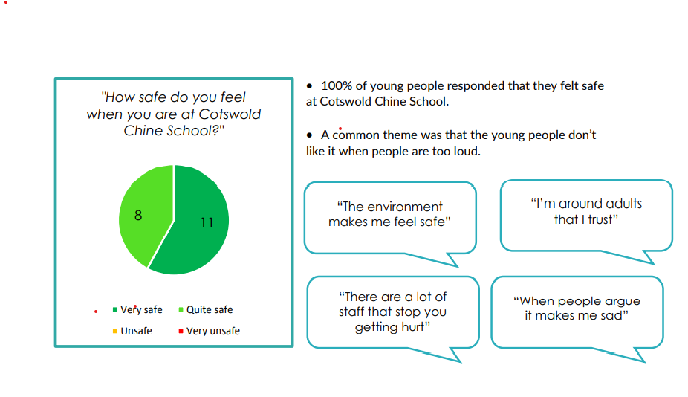

Slide 57
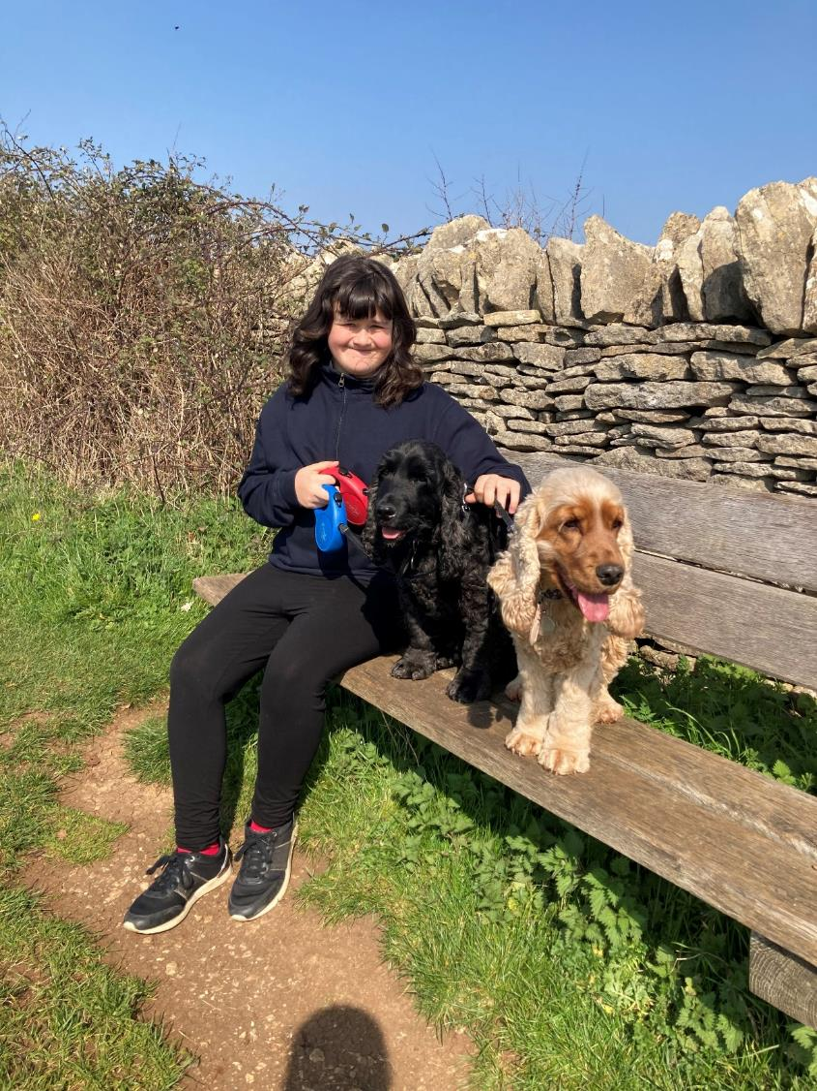
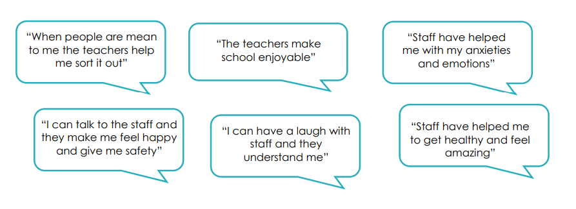


Slide 58

Practice Humility Knowing that one can always learn especially from children
Rudolf Steiner 1903

Slide 59



Slide 61

Survival is more important than reasoning
Everything about us our minds our brains and our bodies leads to collaboration, social systems, this is our most powerful survival strategy.
Problem solving in the neocortex is philosophical and well thought through
Problem solving in the limbic and diencephalon is emotional and ultimately reactive
Problem solving in the brainstem is reacting and you’re essentially not thinking.

Slide 62

Behaviour that Challenges
Challenging for who?
Challenging behaviour being displayed by someone for them meets a particular need, it may be challenging for us, but its not necessary challenging for them………..
Our aim is to demonstrate curiosity and ask ourselves what is trying to be communicated to me?
What am I not understanding………?

Slide 63
October 2014
Sanctuary Model Launch Day
October 2016
Introduction to Systemic family work
November 2018
NMT Cohort 2 begin their training
2014
Trauma Art Narrative Therapy (TANT) training
May 2016
Sanctuary Training
October 2018
Working with families from a trauma informed perspective
January 2018
TANT Training
April 2016
6 Steps to Restraint Reduction
October 2018
Working to reduce the use of seclusion and restraint
January 2018
Level 4 Trauma Informed Care Qualification begins
September 2019
Systemic family work reflective workshop
January 2017
NMT Cohort 1 begin their training
October 2018
NMT Phase 2 group begin ‘Train the Trainer’ certification

Slide 64

UK Covid lockdown
School Holidays

Slide 65
Successful de-escalation strategies and Positive Behaviour Support
Collection of most successful de-escalation strategies used with the young people and any near misses during the week
Data is fed into Support, Advice and Strategy meeting/ Clinical Therapy meeting to review effective strategies. Update to monthly Restrictive Practice Analysis report and individual Positive Support Plans
Consultation with staff team about de-escalation strategies that have been effective with young people and what lessons have been learned. Use of case studies.
Direct training to staff on effective de-escalation strategies (informed by current data), relational health , near misses, lessons learned and proactive behaviour support.
Six Core Strategies

Slide 66


Slide 67

Gentle Supervision provides a child with a sense of safety through basic physical proximity
In the absence of close support children can fall into a pattern of negative attention seeking due to the fact that they are alone and cannot regulate their own emotions or anxieties.

Slide 68

The combination of providing structure and predictability in line with gentle supervision can have the effect of allowing children the safe framework in which to experience success and acknowledge mistakes.
“Supervision and Time in”
should always be seen as a gift and not a punishment.

Slide 69

Rather then isolating children when they are misbehaving or having a tough time, adults should consider bringing the child or young person closer to them.
By increasing closer physical proximity in order to provide a background of safety rather then generating anxiety through isolation. We intuitively do this when children are sad or frightened , but it tends to be forgotten when children are angry.

Slide 70

Relationship Repair not Withdrawal
Daily life often presents circumstances that reduce the young peoples sense of safety.
Conflict between young people, an unpredictable event, or something that brings back painful memories of the past can present as a sudden change in perceived safety and leave young people anxious and uncertain.

Slide 71

Relationship withdrawal generates fear of separation or even abandonment, which is likely to undermine a young persons sense of safety. It can also lead to young people feeling a strong sense of shame.

Slide 72

The Chronicles of Covid Lessons Learned:

Slide 73

We started with Hope
Optimistic and hopeful view points have a direct correlation to better outcomes in the face of adversity,
The importance of hope-linked to the activation in the circular cortex at the front of the brain, this is where we house our belief systems
Dr A Hamilton 2003

Slide 74

OFSTED inspections in the “COVID” period:
Education – Compliance inspection: 8th
December 2020
Education – Full inspection: 25th January 2022
Care – Full inspection: 3rd November 2021
Ofsted - GOV.UK
Ofsted is the Office for Standards in Education, Children’s Services and Skills.

Slide 75
Cotswold Chine School 7-19yrs | Paradise House & William Morris College 18-65 yrs
(March 2020-May 2022): Positive cases in Children = 21 (36% of Children) Positive cases in Teachers = 12 (48% of Teachers) Positive cases in Care Staff = 17 (74% of Care Staff) Positive cases in Therapy Staff = 14 (54% of therapists) Positive cases in YSW team = 5 (83% of YSW) Cotswold Chine School STAFF Total = 65% of staff have been absent with Covid | Post September 2021 we have had 2 outbreaks (Sept 2021 and (March - May 2022). 19 residents (21 cases) have contracted covid, with 2 getting it twice. 63% of residents. 23 members (27 cases) of staff have contracted covid with 2 staff getting it twice and one member of staff getting it three times. 59% of all Care, Workshop, Activity, Clinical, Admin & Management staff. Total infected: 42 people Total cases: 48

Slide 76
"The Great Resignation:
'Whatever the situation is, I want better,’”
At Novalis we employ 278 staff in total.
123 staff + 5 years employment
33 staff over 10yrs, 19 staff over 15yrs, 10 staff over 25 yrs. , 9 staff over 20 yrs., 7 staff 25yr-50 yrs. Length of service at Novalis Trust
In 2021, 47.8 million workers in the United States left their jobs voluntarily
In the UK, where an adjustment of the employment market related to Brexit is also unfolding, there are now 4.4 vacancies for every 100 jobs — an all-time high
"It's this recalibration that people have had where they're rethinking the role of work in their lives,“
Renumeration — flexibility, purpose, balance.“
In professions like nursing, especially, there are signs that burnout is reaching unsustainable levels. A survey of more than 9,500 nurses by the UK's Royal College of Nursing published late last year found that 57% of respondents were thinking about leaving their jobs or actively planning to leave. The top reasons given were feeling undervalued and feeling exhausted.
By Julia Horowitz, CNN Business
Updated 1504 GMT (2304 HKT) March 30, 2022

Slide 77

Faces at the office Windows
We have created a new position to bridge the gap between
“what we say we do” and
What we actually do”
The Training and Practice Supervisor
Full time posts one for each home
7 in total
Mentoring all new staff
Focusing on
Appreciation, coaching, and evaluation systems

Slide 78

Final Thoughts
Essentially it needs to be Relationship Based
Pandemic (no one was going to rescue us)
Information overload followed by nothing, plot your own course
The remembering self-the experiencing self
Hope and positivity, co-regulation –self regulation
Our young people have coped with so much adversity that in a way they were better prepared then we were.
Gaps in knowledge between what we say we do an what's happening in the homes.
A shift in staff recruitment and support, a focus on appreciation –drop evaluation for now.
Difficult conversations, almost always end up being about identity, feelings am I worthy, do you care?
Hope and kindness, gratitude and a sense of moral purpose helps
An active drive to promote, training, support and good relational health can create a culture that acts as a protective factor in the face of adversity, and equip people with the skills to stay self regulated positive and ultimately avoid the use of restrictive practices.

Slide 79


The “Knower”
The “Doer”

Slide 80

With the “knower” and the “Doer” we often forget the most important person of all the “knowing Doer”

Slide 81

The Team of
“Knowing Doers”

Slide 82

The remembering self-
the experiencing self
“Its not what's wrong with you, its what's happened to you”
Federaro 1997
“I am not what happened to me, I am what I choose to become”
C Jung 1959
Are we coping with Covid?
Did we cope with Covid?
Hedonic psychology, Kahneman

Slide 83

Questions & Comments
Jake Lukas RSW, MBASW
Chief Executive
Novalis Trust tel 01453 837550 www.novalis-trust.org.uk
E-mail Jake.lukas@novalis-trust.org.uk

Slide 84
References and Further Reading:
Examining Child Maltreatment Through a Neurodevelopmental Model of Therapeutics Bruce D Perry Child Trauma Academy
D Hughes : Rowman & Littlefield; 3rd ed. (Jun 2017) Building the Bonds of Attachment Awakening Love in Deeply Traumatized Children
Stone D Heen S : Thanks for the Feedback (2019)
Stone D, Heen S, Patton B, Difficult Conversations (1999)
Lukas J, Novalis Trust Statement of Purpose (2021)
S Bloom Creating Sanctuary, Towards Sane Societies (1999)

