Slide 1
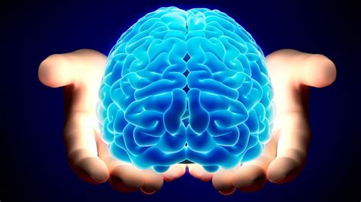
The Ecology of Resilience
The Neuroscience of Amplifying Strengths
Threshold GlobalWorks (c) 2022
Laurie Leitch, PhD

Slide 2
True or False…..
Or …“sort of”
I have a self-care practice that supports my physical & emotional health
I know that when challenges arise I have a support system to rely on
If I learned a new way to tackle challenges I would be excited

Slide 3
Today’s Presentation Goals
To offer a lens that excites you about ways to think about your life, your organization, and the vulnerable populations (children & adults) that you serve
To describe the power of 2 of SRM’s core neuroscience-based concepts for creating coherence in the design of policies, programs, and practices
To explore how neuroscience can offer a roadmap of concepts (and skills) that can contribute to the health of your nervous system and the “nervous system of systems”

Slide 4
What is an “Ecology” of Resilience?
An orientation that incorporates an understanding of the interdependent layers/systems of influence that affect potential and positive outcomes;
It includes the individual-level and systems-level factors that help deal with change and complexity in health-enhancing ways;
It recognizes the limitations of intervening in just one part of a system.

Slide 5
The Basic
Building Block:
Your Brain
You have the power to change your brain

Slide 6
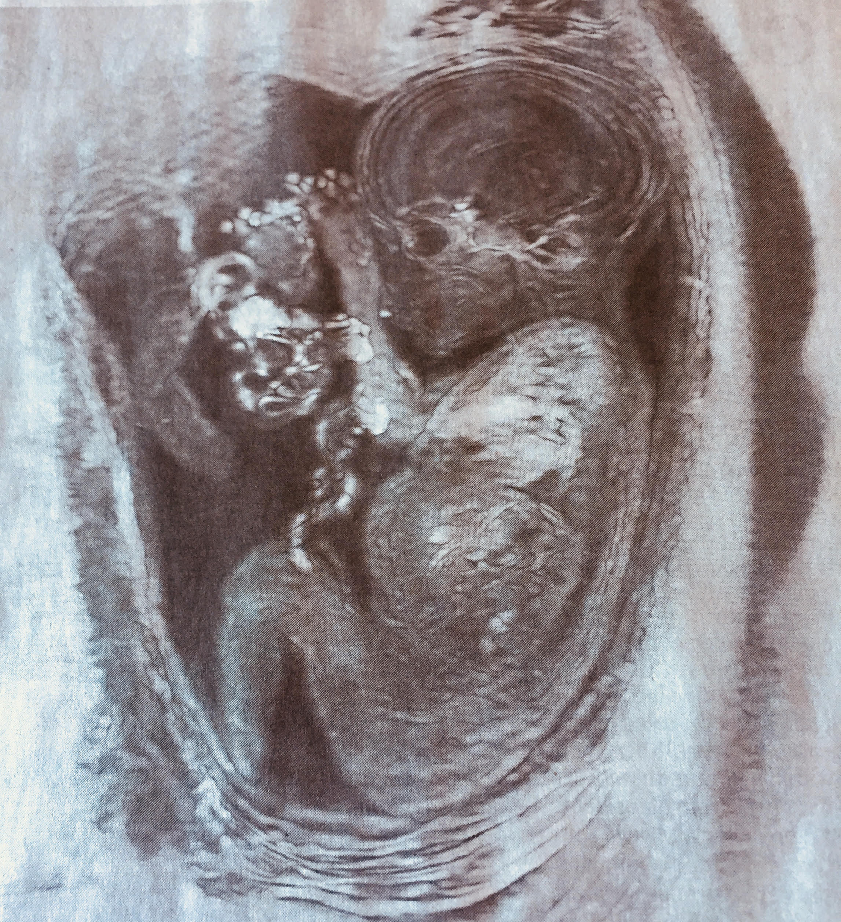
We Have a Social Brain and it is shaped by many systems
Stress
chemicals
pollution
Food scarcity
The human nervous system begins to be shaped
in utero by other systems

Slide 7
The Impact of Stress, Distress, & Trauma
“The brains of children living in ‘marginalized communities’ show tangible alterations” - emotional regulation
- cognitive function
These effects can have a ripple effect across generations
( from: Cerebrum Dana Foundation.
4/22)
We also know that parents of special needs children can have PTSD
-in one study of hundreds of parents with children on the spectrum 18.6% met the criteria for PTSD.
( from: https://disabilityscoop.com/2020/03/10 )

Slide 8
Fear can live in the bodies of children and adults as well as in the bodies of communities
The Body
As Storyteller
“Trauma has nothing to do with cognition. It has to do with the body being reset to interpret the world as a dangerous place.”
van der Kolk, 2014

Slide 9
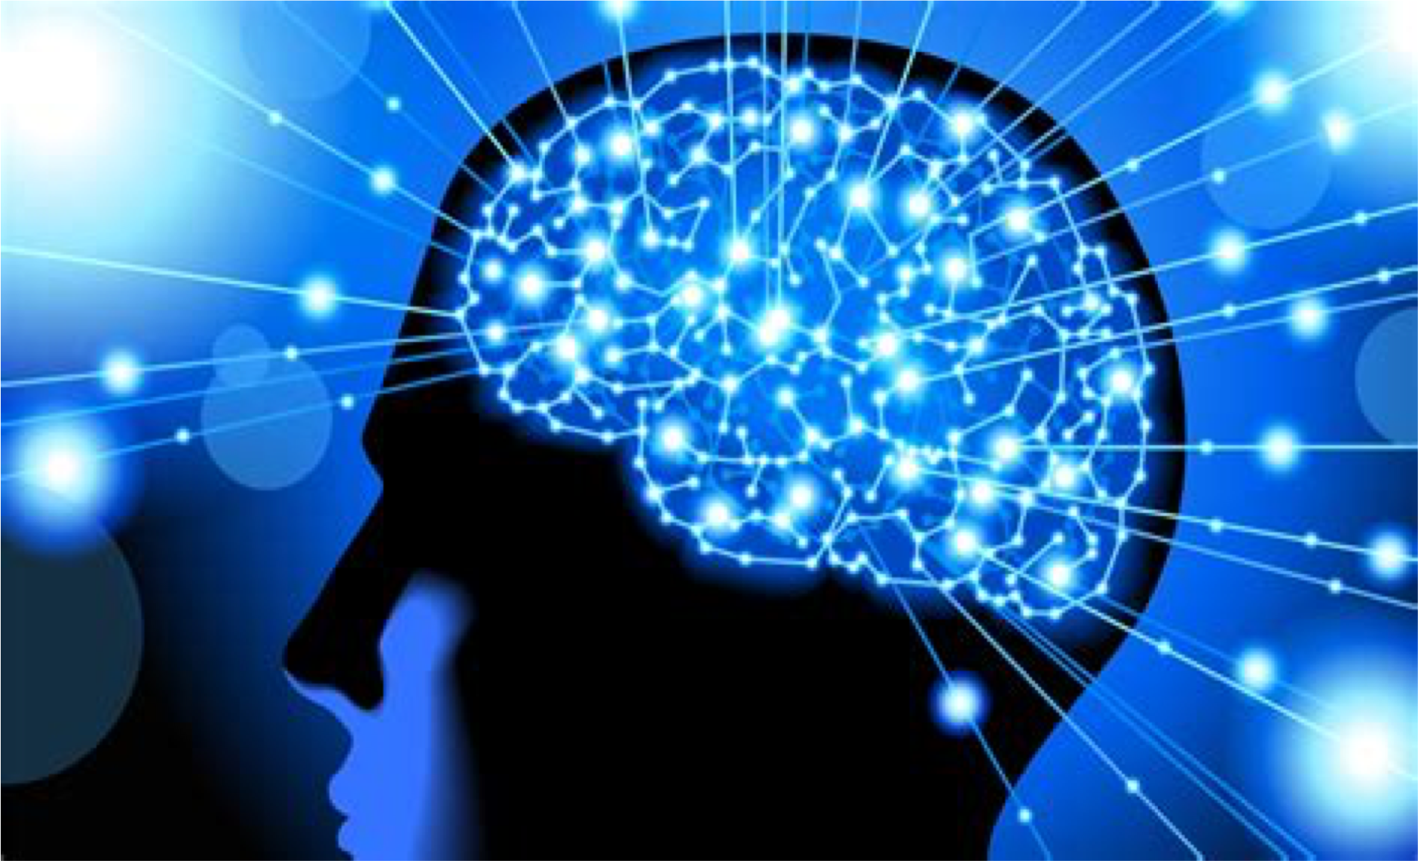
The Good News is the brain can change for the better:
In ways that:
because of neuroplasticity:
The brain’s capacity to grow new neurons and prune away others
increase self-regulation and decrease reactivity
increase pro-social behaviors
create a climate of health in the body by decreasing stress chemicals

Slide 10
The Human Nervous System: this is the system we have the most control over
SRM focus:
The 2 branches of the ANS
Sympathetic: activator
Parasympathetic: calms
As in all of the natural world there are cycles and rhythms in our human bodies

Slide 11
Our Natural Balance:
All of us are wired with the potential to be resilient
We can learn 1) to stay inside the Resilient Zone or
2) return to it faster
3) deepen the Rzone through skills practice and positive experiences
Charge:
Sympathetic Branch
Release:
Parasympathetic
Branch
Resilient Zone
The Science Behind Resilience:
Learning to control reactivity, decrease stress chemicals,
and boost pro-social behaviors in children & adults
Adapted from work Dan Siegel
11
11
11
Notes:
.

Slide 12
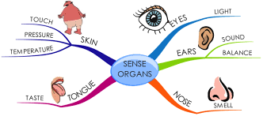
A Key Player in Shaping Our Behavior: The Amygdala: Our Brain’s Smoke Detector
Has a “negativity bias”
Translates sensations from the outside world
What’s unexpected/novel?
Is there a threat?
It can become mis-calibrated
assesses safety: below our level of consciousness
It creates patterns from highly charged emotional memories such as fear & terror that can become “triggers”
Graphic from Healthinterpreters.org
Notes:
Siegel’s Hand brain

Slide 13
Bumped out of Resilient Zone
Stressful Event
or
“Triggers”:
Impact on the individual
Hyperactivity
Hypervigilance
Mania
Anxiety & Panic
Anger, Rage
pain
Stuck on “High”
(amped up)
Resilient Zone
Depression
Disconnection
Exhaustion/Fatigue
Numbness
Stuck on “Low”
(no “juice”)
Bumped out of Resilient Zone

Slide 14
“Brain Food” 2 interdependent essentials that the nervous system must have in order to do its best & stay in and deepen the Rzone
1. Safety
When there is a sense of safety, better relationships
can be created
Without a sense of safety stress chemicals build up, toxify the body, and shut down clear thinking
The stress chemicals start to build up
2. Attachment
When there are positive relationships, the amygdala “relaxes” its vigilance
When the amygdala relaxes, better relationships
can be created
Threshold GlobalWorks (c) 2022

Slide 15
Safety in the Body Comes First
The Amygdala:
A key influence in our perceptions of safety
Wired to scan for novelty, especially “threatening” novelty
Must be inhibited to function properly
Can become miscalibrated
The Autonomic Nervous System:
Influences every organ
Mobilizes us
Calms us
Can get “out of whack”

Slide 16
Attachment: Shaping Resilience
Attachment to caring individual(s) shapes the nervous system
Bonding begins during gestation
Access to information and resources
Neighborhood &
Community programs
A systems-level example of attachment:
Our assessments need to take into account the degree to which families know how to provide and to access safety and attachment-oriented services/experiences
As providers how do we advocate for those in the community?

Slide 17
Expanding the Nervous System Lens: thinking ecologically
The processes at the individual level also characterize the systems level
Including the the need for Safety and Attachment

Slide 18
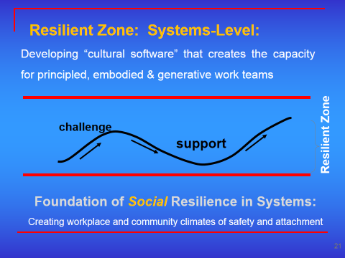
SRM: Expanding Resilience from Individuals to Systems of All Sizes
And communties
Organizational plasticity
Threshold GlobalWorks (c) 2014

Slide 19
Dysregulation: A Systems Lens
***Add the impact of Covid & national-level challenges
Threshold GlobalWorks (c) 2022

Slide 20
Safety: Examples in homes, schools, and communities
Pre and post-natal classes for new mothers (inc. “spoiling,” corporal punishment, the role of healthy food)
Kids and Cops programs and After-school homework centers
Workers who are sensitive to the signs of distress and trauma in kids, parents (& selves) and have tools to deal with them
City and State-level policies that support local-level dignity, positive attachments, and safety

Slide 21
Ecological Approaches with Children: How are children integrated into our communities?
Such as:
Responsible adult supervision
Opportunities for empowerment
Clear boundaries and expectations
Developmentally-appropriate activities
Being known & reinforced for strengths

Slide 22
We Are Each Wired for Resilience…and We Need the Proper :”Brain Food”
The message is ageless: safety and attachment build and support resilience.
Practical, positive &
productive…
and it applies to systems of all sizes

Slide 23
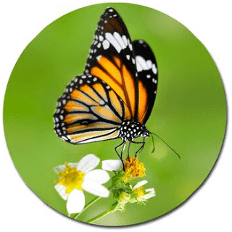
Ecology: A Story of Interdependence
The biological story is that the caterpillar eats many times its weight per day, and then when it forms a chrysalis, it goes into a quiescent state. At that point the precellular entities called imaginal discs start to form. They’re not full-fledged cells yet, and when they first appear the immune system actually wipes them out.
So long as the discs are independent and separate they are snuffed out as if they were foreign bodies. But as the metamorphosis goes on, more and more discs are created, and soon they start coming faster and clustering together and the immune system just breaks down. At that point the body of the caterpillar begins to turn into a soupy nutrient fertilizer that nourishes the discs as they turn into full-fledged cells. These cells develop into the butterfly….a real chemical transmutation.
Elisabet Santouris

